Slide 1
Migrants, Precarious Employment and Workers’ Rights
Owen Espley – War on Want

Slide 2
Contents
Context:
Campaign Approach
Campaign Actions
Next steps…

Slide 3
Embedding Hierarchies
The Issues:
  Post-Brexit: racist attacks and new migration regime
  Growth of insecure work
Context:
  Austerity and privatisation
  Erosion of universality
Threat:
  Response to insecurity is to protect national, racial and gendered privileges.

Slide 4
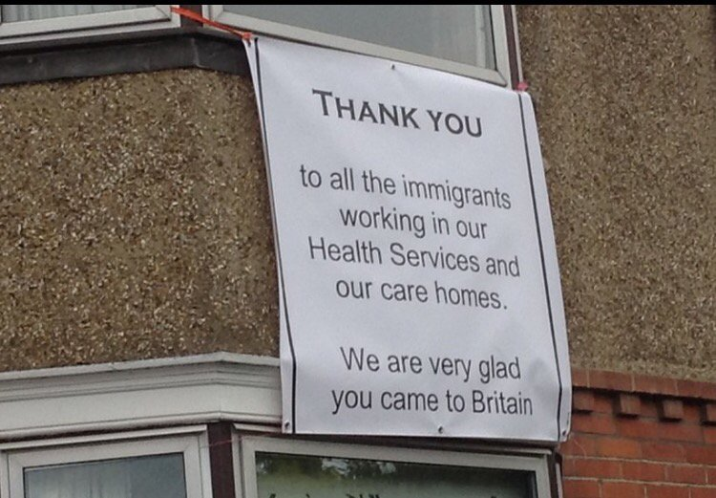
Hierarchy of Employee Contracts
Employee
Zero Hours
“Worker” e.g. agency workers
Bogus self-employment / “gig economy”
Notes:
Link between those sectors of work that are lower in the hierarchy and those who face multiple oppressions: e.g. care work done by women, work perceived as for young people, cleaning etc,

Slide 5

Hierarchy of migration status for workers
UK Citizen
Right to work attached to migrant e.g. points based type system
  Social rights: health care, family life?
Work Permit System:
  Worker tied to an employer / sector /
Undocumented Workers
  Less able to claim rights
Notes:
These categories already exist- but could be greatly expanded under a new post brexit migration regime.
Its also a bitter irony that any system which seeks to reduce the number of migrants will increase the number of undocumented workers.

Slide 6
Hierarchies in Practice
Outsourced largely migrant cleaners at LSE not entitled to same holiday, pension etc
Sports Direct: women workers referred to as “fresh meat” by supervisors
  Workplace racism and sexism is harder to challenge on a precarious contract
Theresa May claims to represent ‘the workers’ party’ – but which workers?

Slide 7
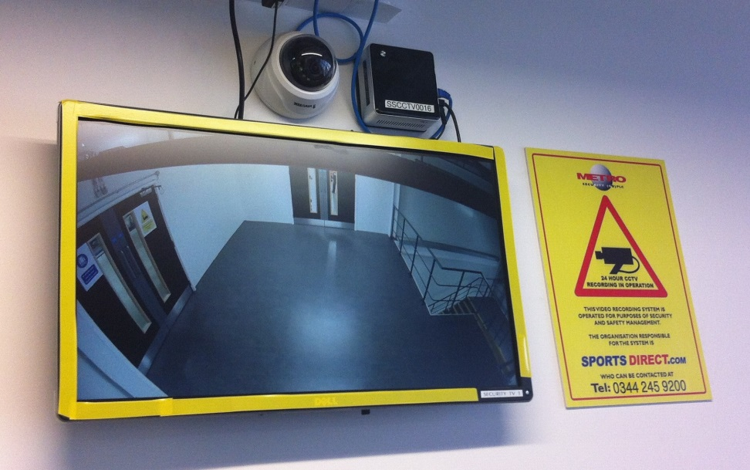
Sustaining Hierarchies
Modern slavery uses criminal approach to labour rights issue.
“Strivers and shirkers”
  Benefits sanctions
  Public services conditional and rationed
Non-traditional worker used as rationale for flexible working.
  e.g. seasonal migrant agricultural workers / mum with family responsibilities.
Notes:
Hierarchies are sustained not just through rights in practice, but also through the use of criminal law and the public discourse that’s used to justify it.

Slide 8
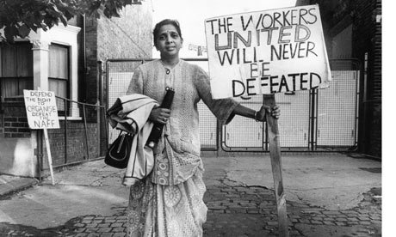
Campaign Approach
Promoting a universal workers rights narrative.
  Precarious Contracts
  Migration system
Mobilising in support of migrant and precarious workers

Slide 9
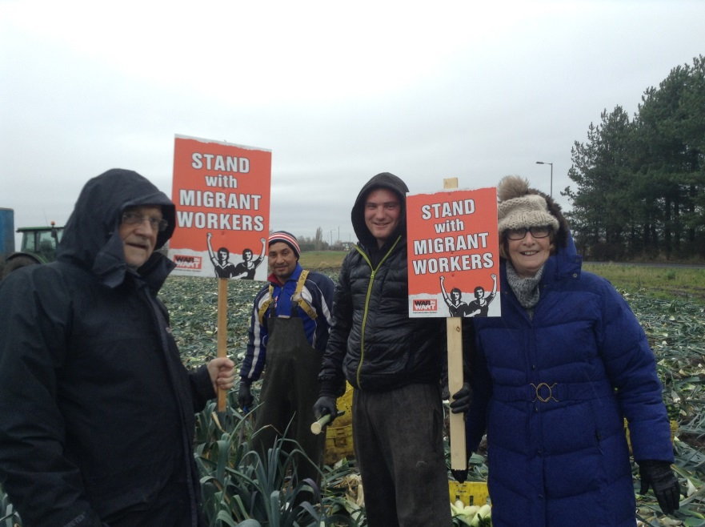
Mobilising Communities
Migrant labour struggles often relied upon community mobilisation
Fight for 15 in the US, uses community support to overcome risk to precarious workers
Appetite from War on Want supporters to take action.
Notes:
Societal bargaining – fight for 15 – linking liberal values to workplace fairness.
Sportsdirect – pregnant women giving birth in the toilet, freshmeat allegations.
War on Want is not a trade union! Key has to be being worker / migrant led – platforming voices – War on Want is there to provide framing and support.
Community mobilisation – migrant history in the UK Indian Workers Association - - sense in which wider community mobilisation is essential to support workers win rights in the workplace.
Grunwick – although in some ways a troubled history – mobilisation of the wider community .

Slide 10
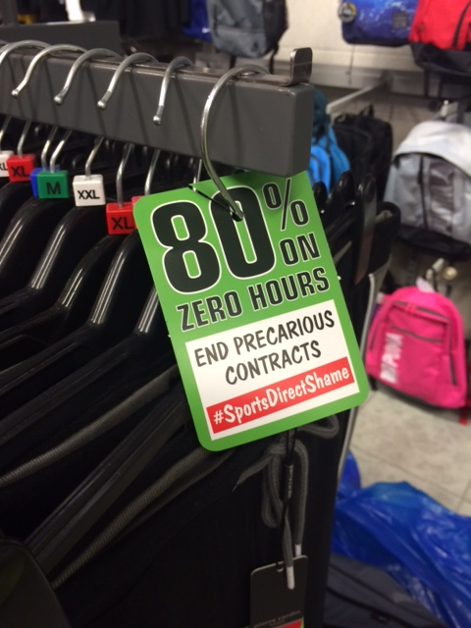
End Precarious Contracts
Highlight workplace abuse
Mobilise in support of workers
Expose exploitation
Notes:
Insecure figures based on analysis of ONS Q2 2015 Labour Force Survey. Analysis takes whole population aged over 16, minus students and people from Scotland and Northern Ireland (Citizens Advice covers England and Wales). Insecure work then based on anyone any on a zero hours contract, reliant on paid overtime, working more than 8 hours overtime per week, on a temporary contract, working for an agency or working particular shift patterns (splits, day/ nights etc and their hours vary)

Slide 11
Migrant Worker Rights
Right to Work
  Right to work for asylum seekers
  Decriminalisation of working
  Separation of labour rights enforcement from immigration enforcement.
Equal Social & Labour Rights
  Labour rights largely similar on paper
  Non-EEA migrants (right to change job restricted, NHS charging etc etc)
  Post-Brexit migration system is a threat
End to Criminalising Communities
  Internal border control:
    Right to rent
    NHS charging
    Immigration raids
    Ending detention.
Notes:
Kley to these demands is to make the case that an injury to one is an injury to all – ultmately
Restrictions on social protection [e.g. welfare benefits] weaken workers’ ability to demand better conditions. If there’s no safety net you can’t afford to be without work: any work. These social protections will be in the firing line during the government's negotiations with the EU. Before the referendum, David Cameron attempted to restrict EU migrant workers’ access to benefits . This attack on social and labour protections will be renewed and intensified during the UK-EU negotiations. In the long run it risks driving down standards for everybody.
Border control is being extended well past the border: immigration raids are happening in communities up and down the country; private landlords now have to check the immigration status of tenants; and doctors and nurses are being asked to check patient's immigration status. People are being forcibly removed from their communities and detained indefinitely. This extension of the border regime overwhelmingly affects black and minority ethnic communities, far wider than the 'illegal' immigrants it is said to target. It creates suspicion, division and tension within communities and must end.

Slide 12
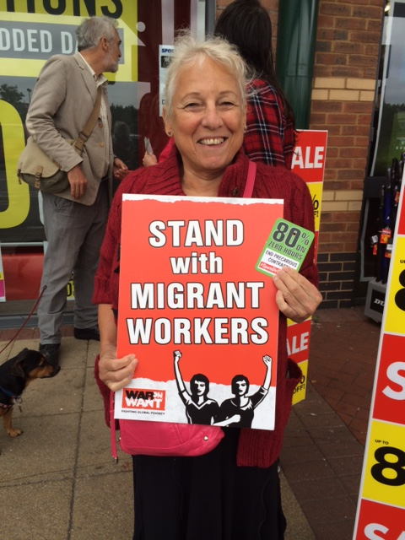
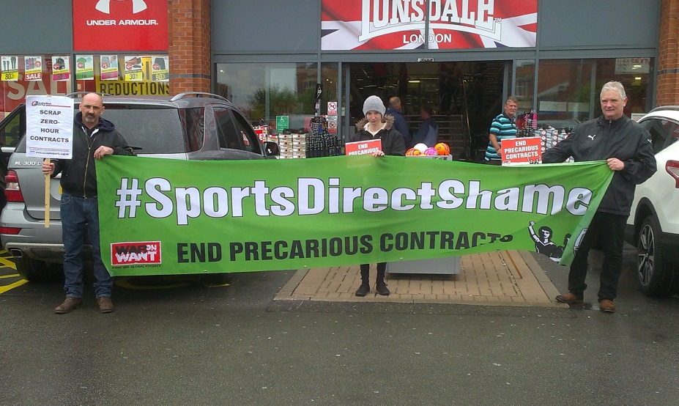
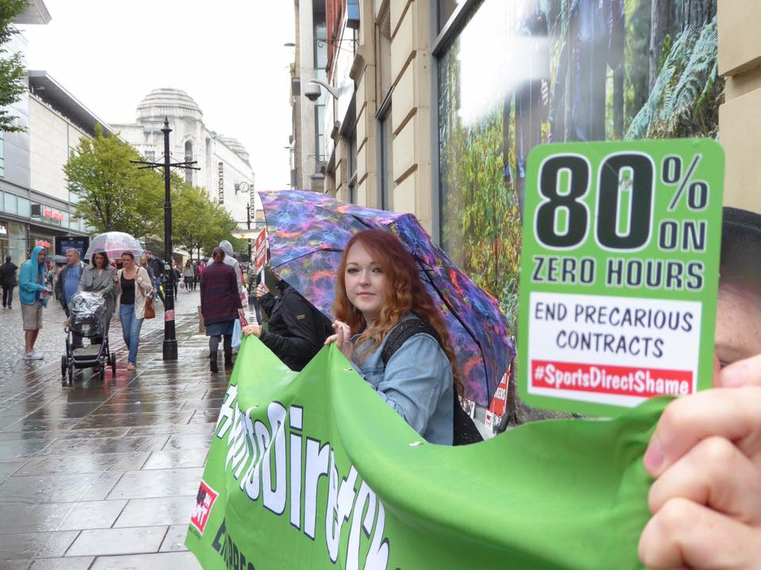
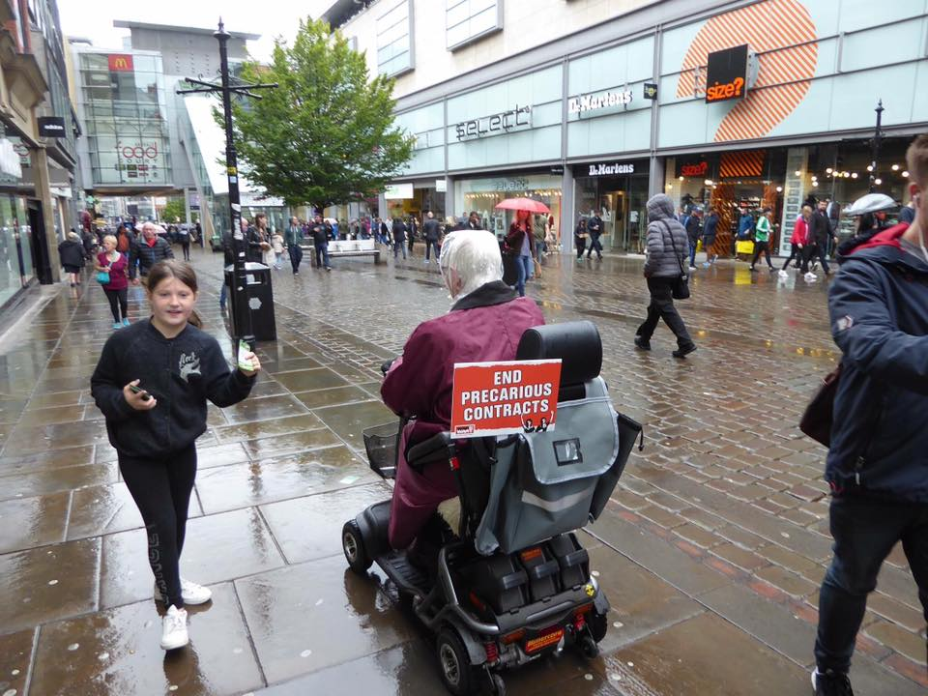
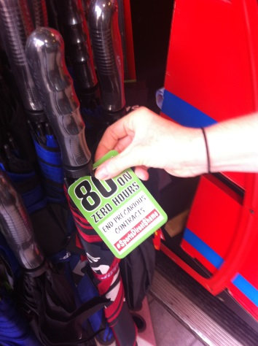
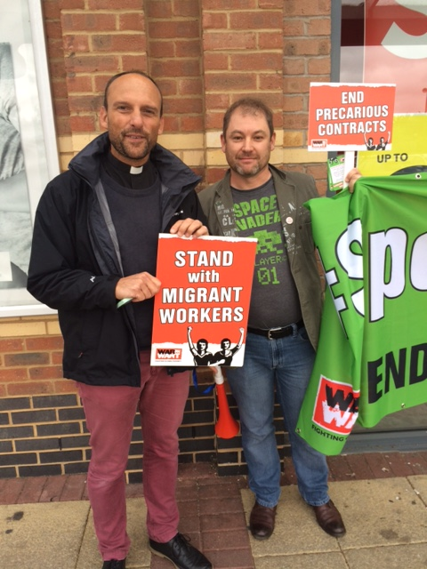
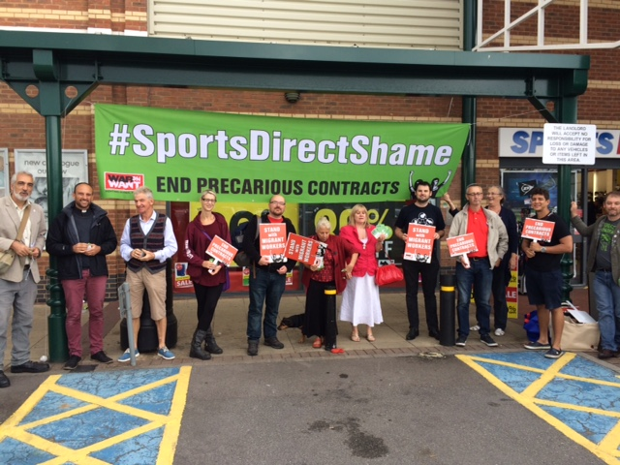
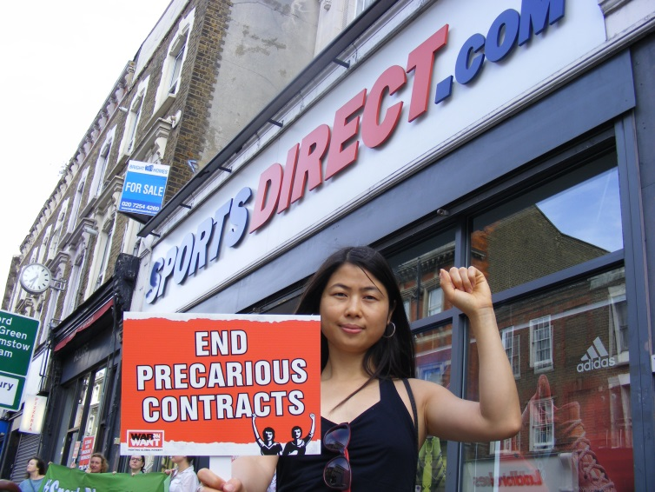

Slide 13
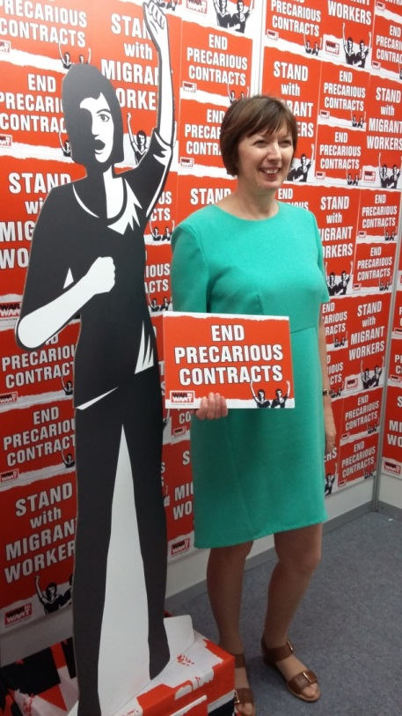
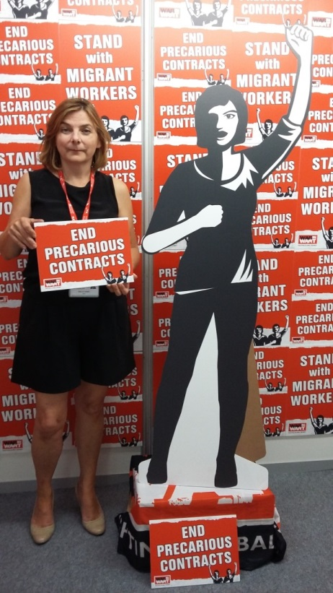
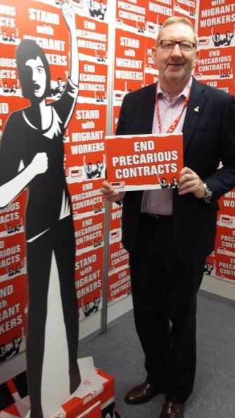
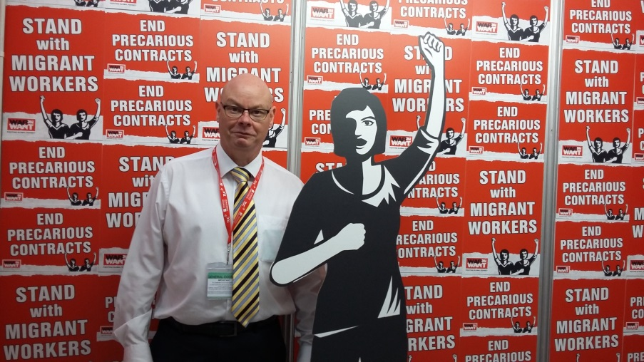
TUC
Notes:
Frances O’Grady – TUC GS, Len McLusky GS – UNITE
Sally Hunt – GS UCU, Steve Gillan GS POA

Slide 14
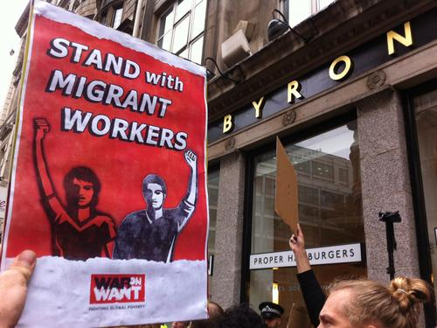
Byron Burgers
Highlights migration regimes impact on workplace
Responding to community campaigns.
Notes:
Byron Burgers.
Ability to be responsive and supportive to migrant led campaigns
e.g. deliveroo / slaveroo,

Slide 15
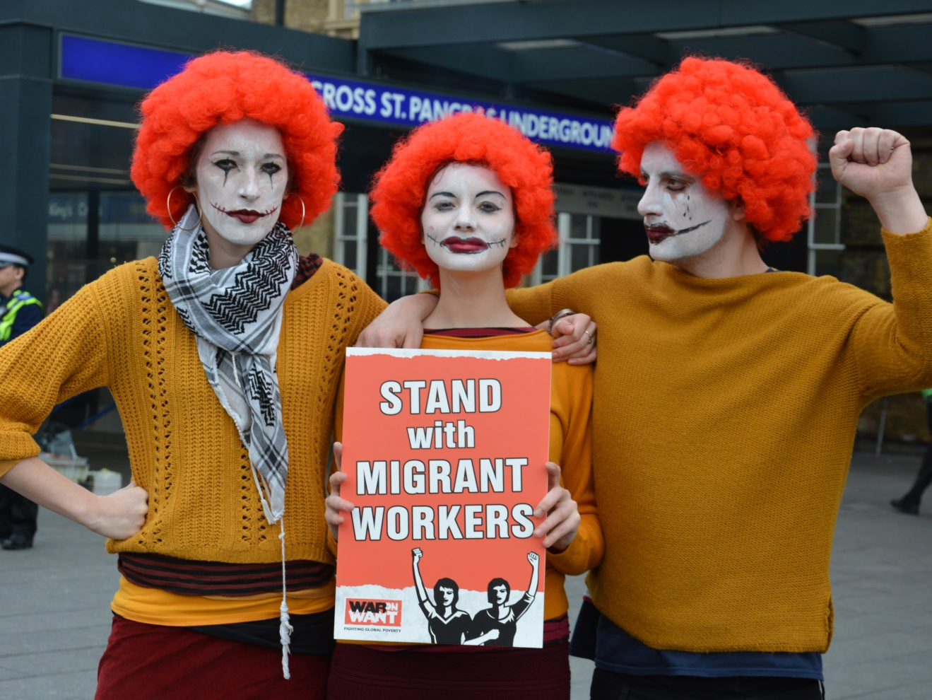

FastFoodWorkers on 1DayWithoutUs
Fastfood workers take action as part of 1DayWithoutUs to demand £10/hr for all fastfood workers.

Slide 16
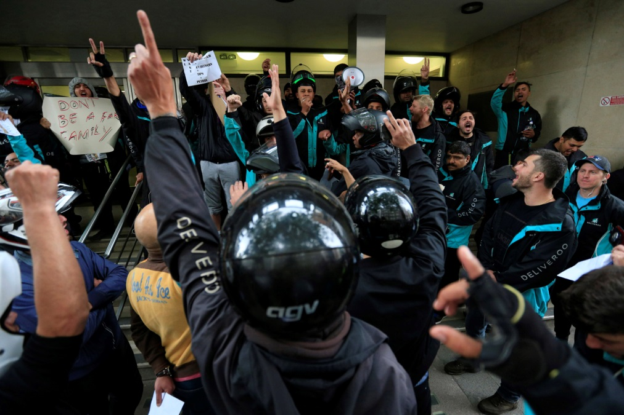
What’s Next
Respond to worker & migrant led campaigns
Expose the migration system’s erosion of workers’ rights
Explore new ways for supporters to take action

Slide 17
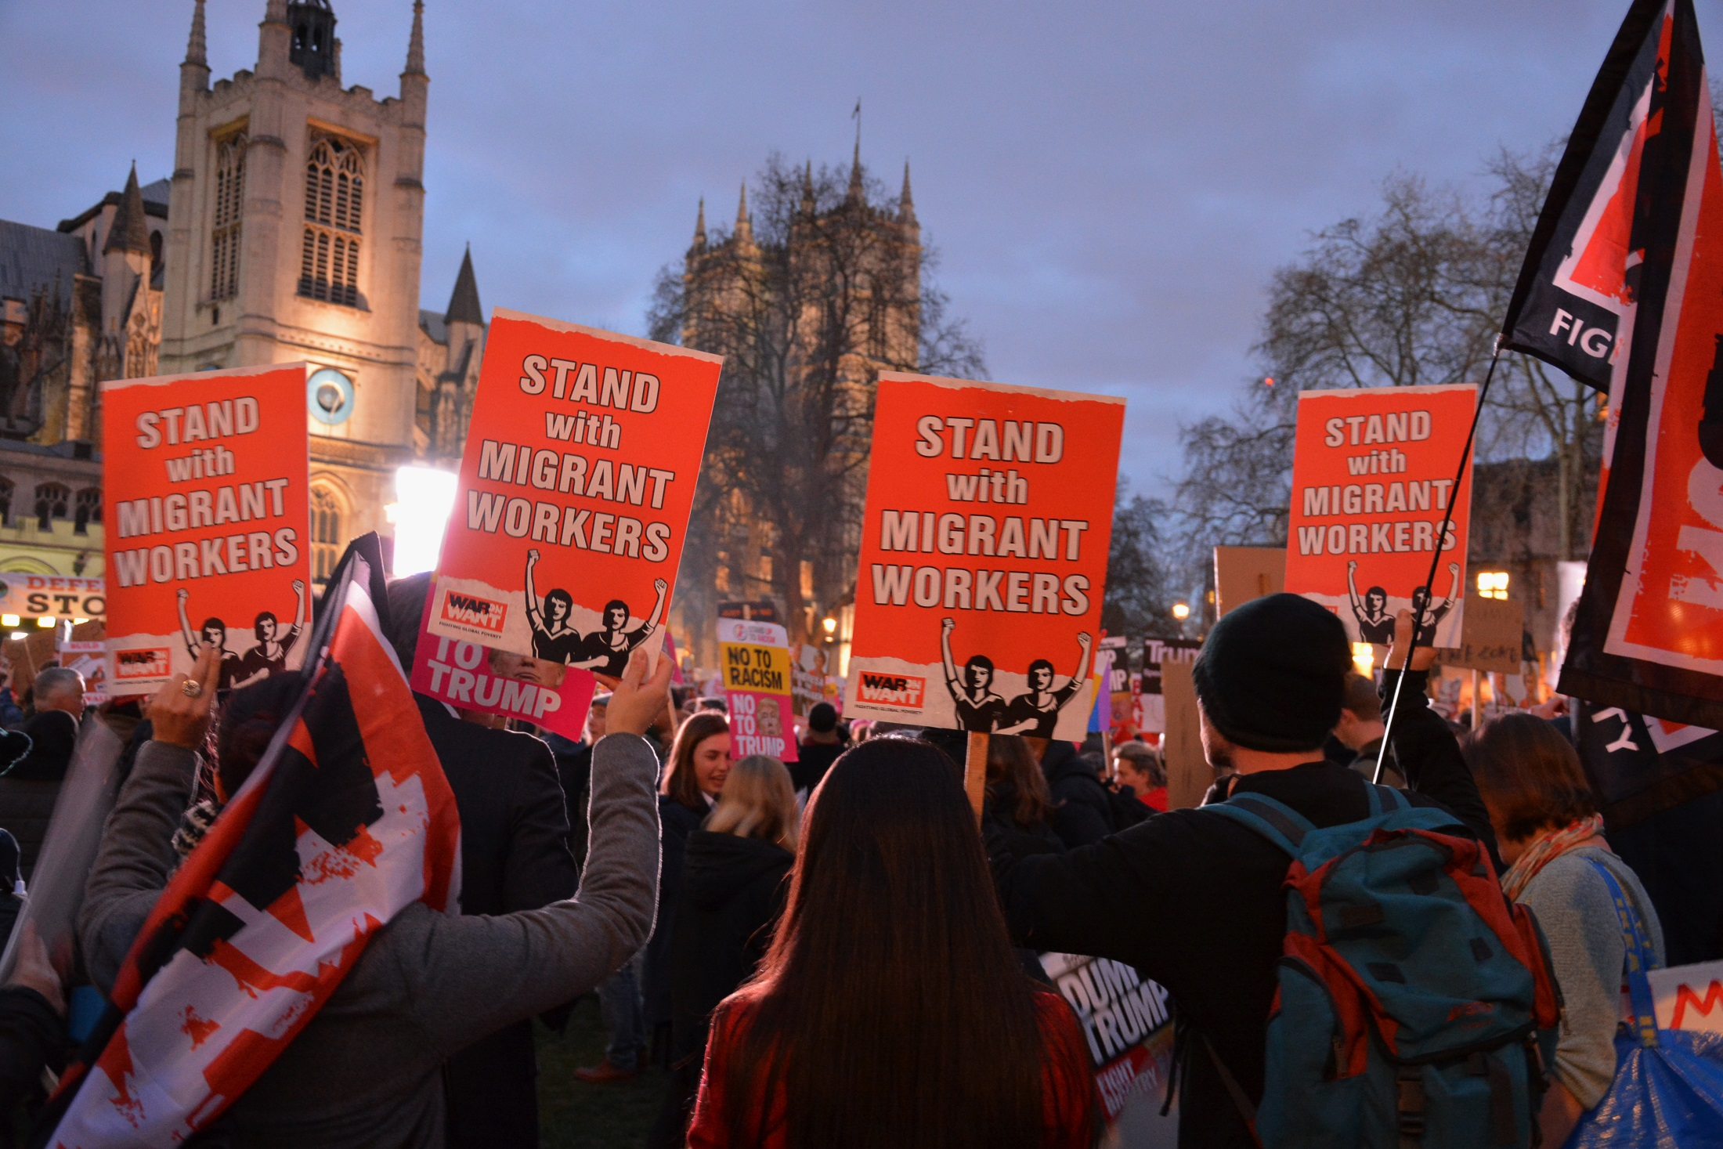
The End

