Slide 1
Organising Migrants in the
Public Service Sector
Susan Cueva
National Development Officer
UNISON Strategic Organising Unit

Slide 2
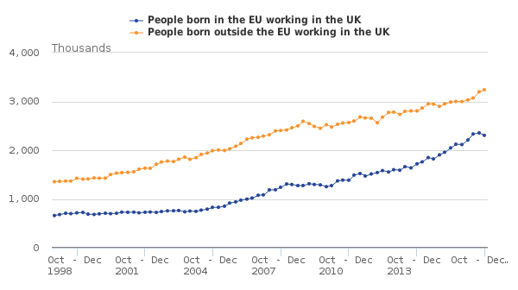
The importance of migrants, the numbers game!

Slide 3
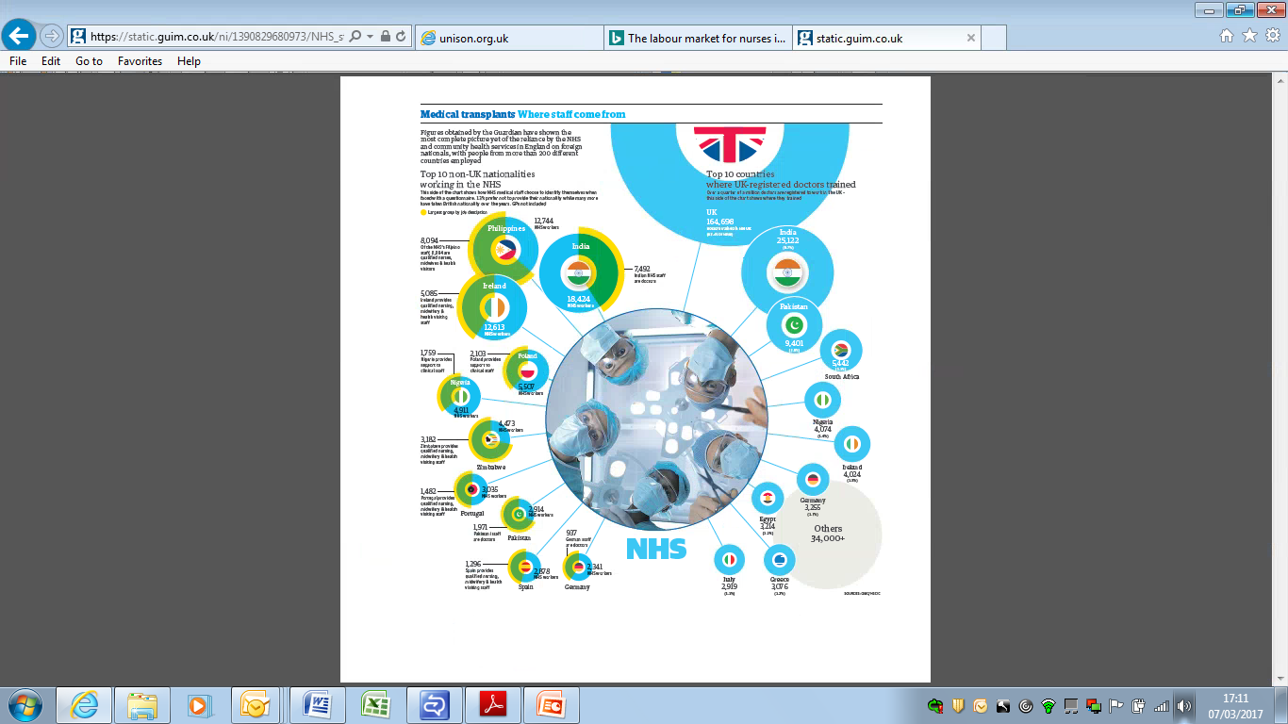

Slide 4
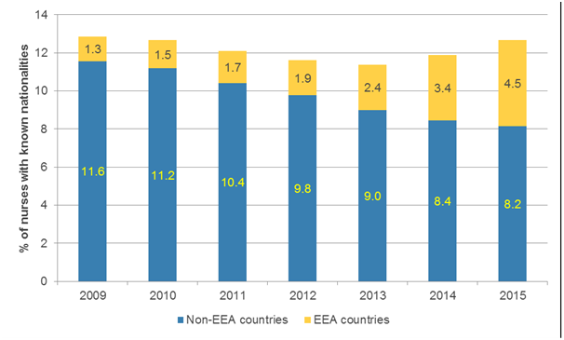
Nurses with foreign nationalities in the NHS in England as a proportion of all nurses with known nationalities, 2009-15
Note: Irish nurses are recorded together with British nurses in the HSCIC data
Source: IES analysis of HSCIC data

Slide 5

The number of migrant workers in UNISON membership is significant
In 2016, a quarter of the overall membership (1.3m) is made up of migrant workers (325,000). UNISON members who are white others is 32,000.

Slide 6

Enabling migrant members to gain power
Campaigning and organising on migrants’ rights

Slide 7
Why immigration policy is a union issue
The cost to migrants and the sending countries of workers migrating to the UK
Visa tied to employers – supersedes employment rights
- unfair dismissal, suspension from work
- unpaid wages, leave pay etc.
- discrimination and bullying
Social cost of migration – separating families, racism, xenophobia

Slide 8
UNISON Campaign: Migrants’ right to stay
Nursing, paramedics, essential health care jobs to be retained in the shortage occupation list for non EU migrants
Campaign to remove the 35K salary requirement for non EU migrants for permanent residency
Rights to stay for the 3 million Europeans – influencing history, protecting people’s rights

Slide 9

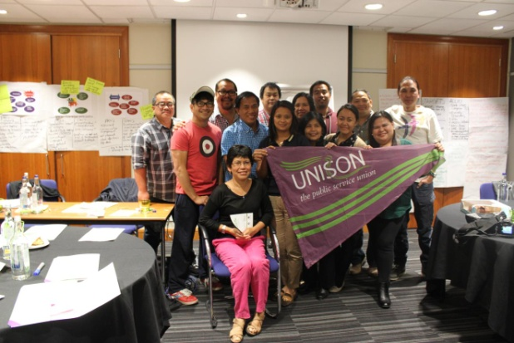
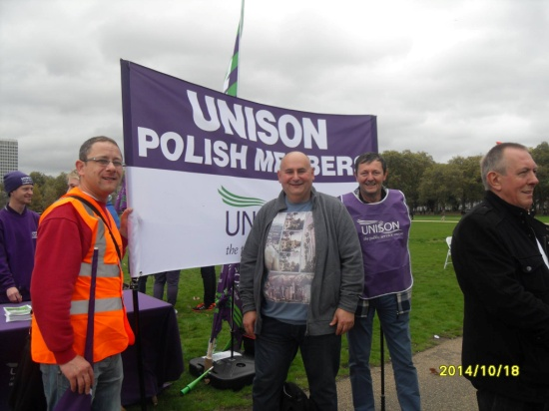
Organising Migrants in UNISON:
Our Migrant Networks
Filipino Activists Network
EU Migrants Network
African Migrants Network

Slide 10
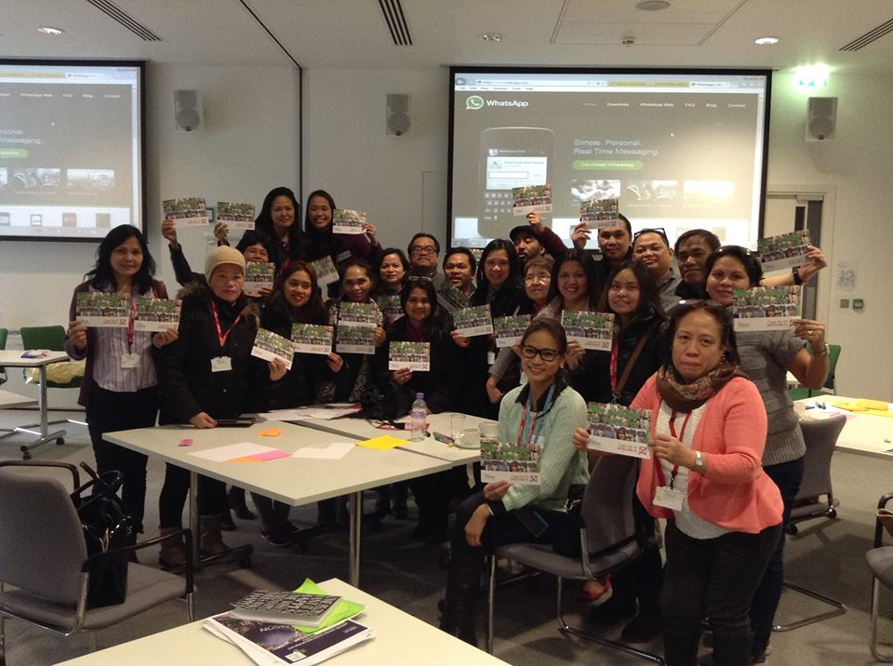
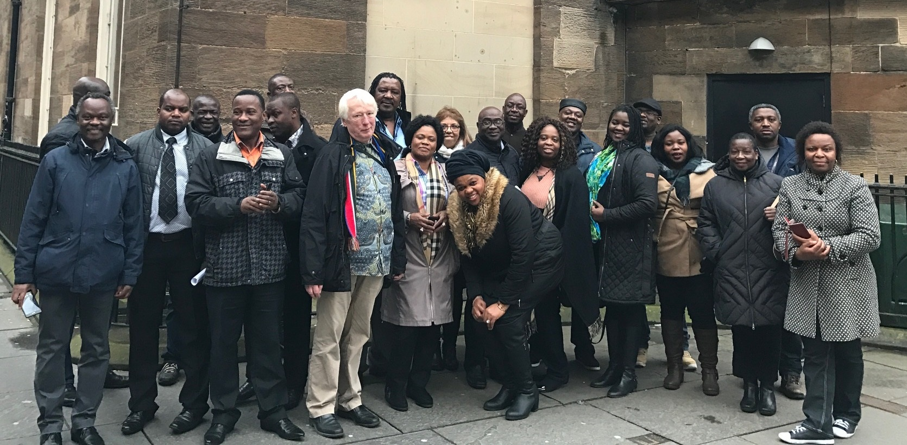
Filipino and African Migrants leadership training

Slide 11
Campaign for Nurses’ right to stay
United campaign of UNISON Migrants Network with migrant organisations, primarily with the Filipino community organisations, Kanlungan Filipino Consortium and the Indian Workers’ Association – lobby parliamentarians, workplace education and raising awareness, rally and demonstration, speaking with media.
Worked with employers, NHS and private care companies, e.g. Four Seasons and with other unions
Lobby and influence policy, - MAC and the Home Office
Work with other community organisations

Slide 12
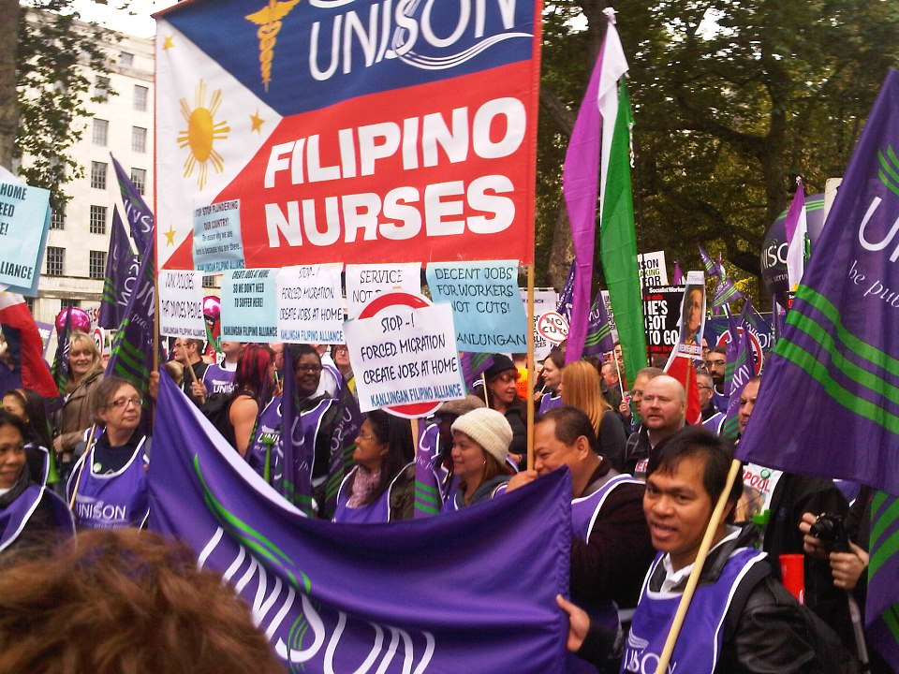
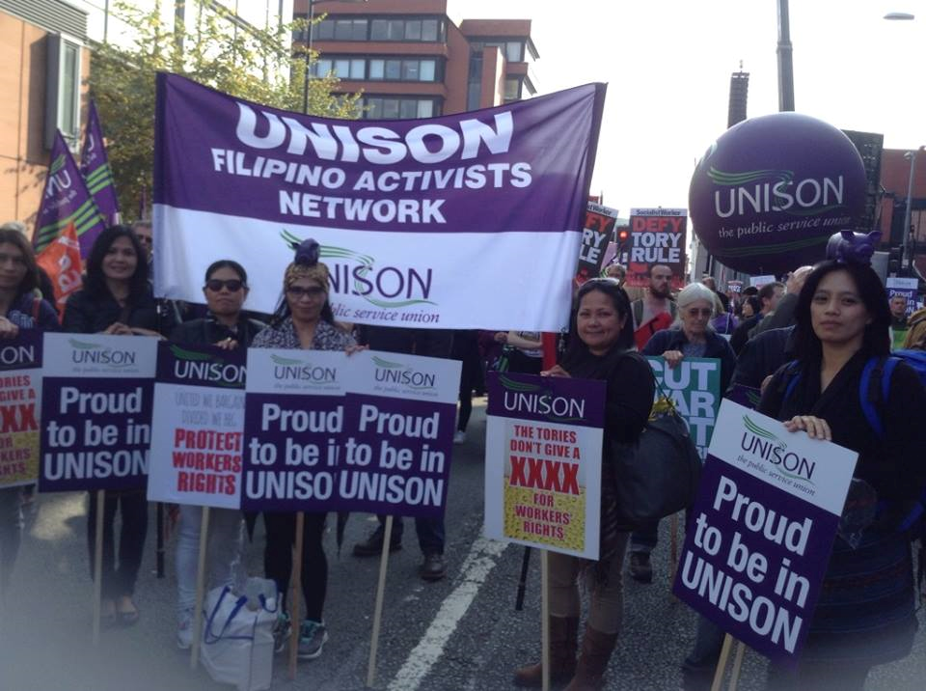
Filipino Activists Network in action

Slide 13
Result of Campaign
Nurses and paramedics jobs were included in the SOL
More members and activists recruited
Migrant activists developed
Recruitment and retention of overseas nurses is on average 80% successful
Won right to stay without the 35K requirement

Slide 14





Exiting the EU: A Pandora Box
Com.Vol.Sector
Racism
Xenophobia
Bullying
Local Government
Visa Issues
Private Companies
National Health Service
TUPE Issues
Pay Issues
Migrant Workers
Health safety
Social care companies

Slide 15
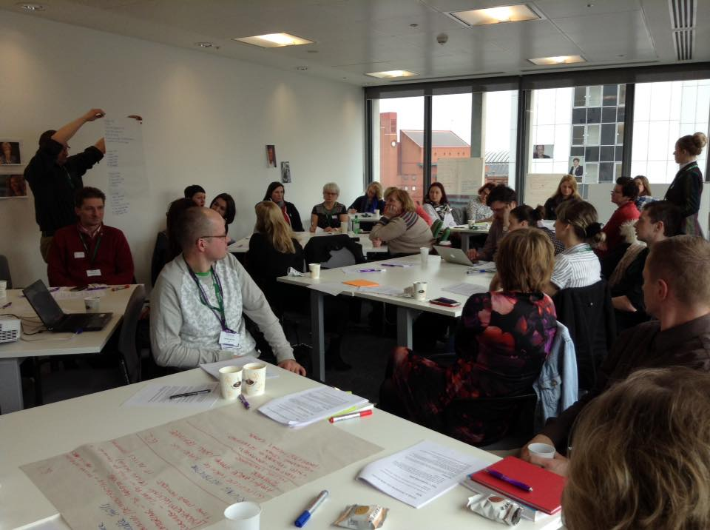
Polish to EU Migrants Networks in UNISON
Campaign to give unilateral right for EU citizens to stay in the UK #righttostay
I am not a bargaining chip

Slide 16


UNISON Mass Lobby of Parliament
https://www.the3million.org.uk/masslobby

Slide 17
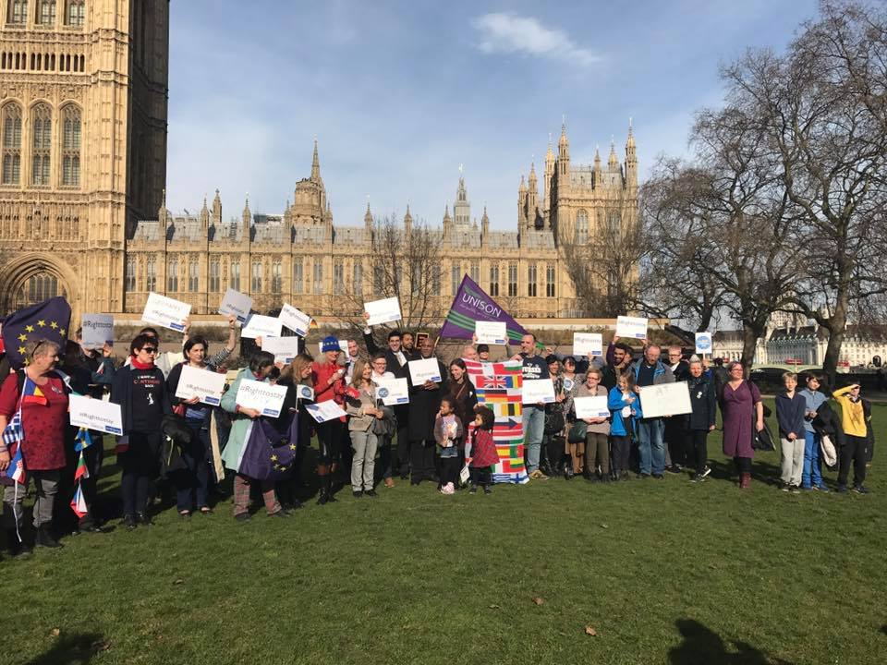
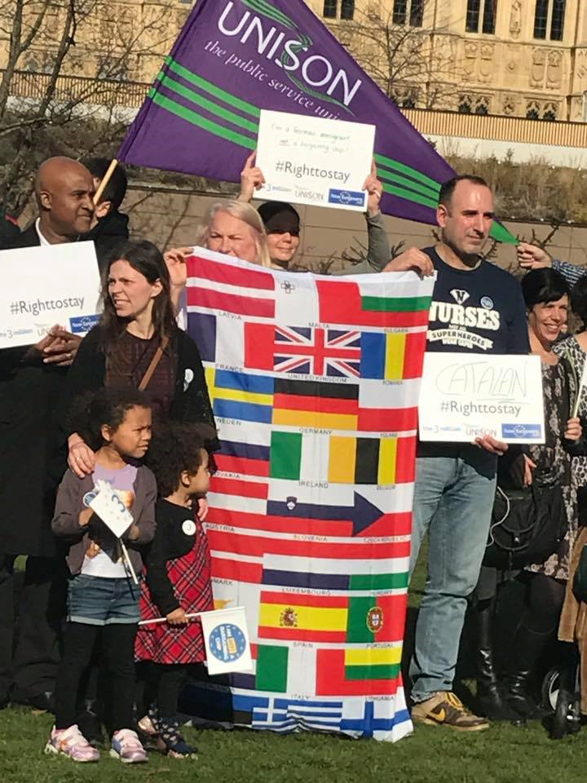
EU Migrants Network in action

Slide 18


UN World Day of Social Justice:
ONE DAY WITHOUT US: 20th FEB

Slide 19
Achievements of campaign- #rightstostay, influencing history
Increased number of EU members and activists in UNISON
Members spoke on issues covered in local and international media
Thousands of members and non members lobbied their MPs and continue to do so
Migrant community groups in local areas are being set up with UNISON support, with local debates and discussions on the issue.

Slide 20
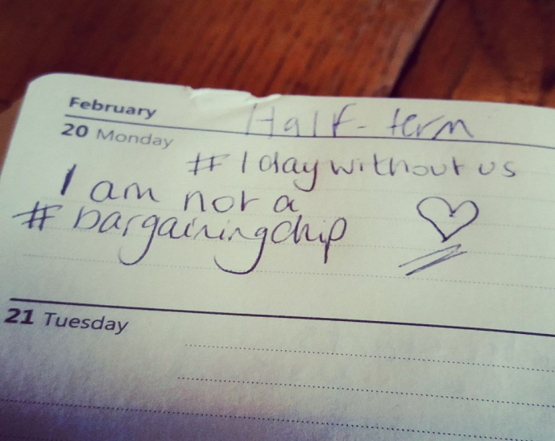

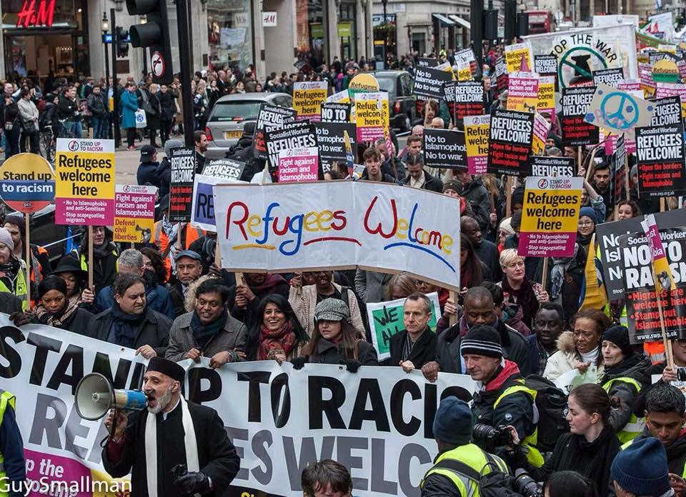

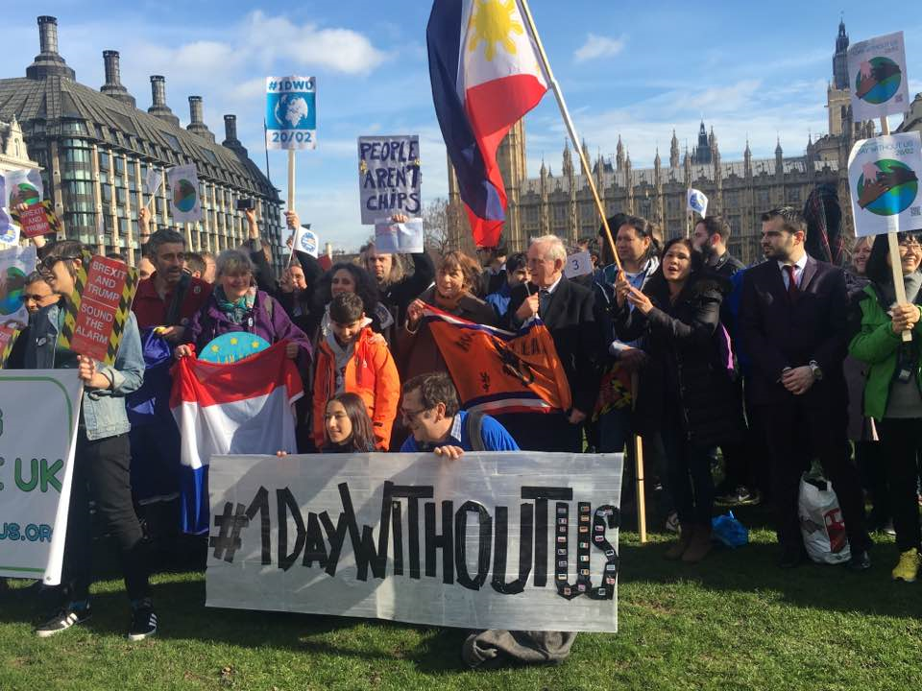
Right to stay for all migrants! UNISON Migrants Network
Alliance for Freedom of Movement

