Slide 1
HSE and Trade Unions
Robert Baughan
UNISON Health and Safety Unit
UNISON
IER Conference 2016
Liverpool | October 2016

Slide 2
Mutual need and mutual antagonism
IER Conference 2016
Liverpool | October 2016

Slide 3
Trade unions: HSE’s biggest friend and biggest critic
IER Conference 2016
Liverpool | October 2016

Slide 4
Robens Report 1972
“....a separate and self-contained organisation, clearly responsible as the authoritative body responsible for health and safety at work”
IER Conference 2016
Liverpool | October 2016

Slide 5
Health and Safety at Work Act: Section 18
“It shall be the duty of the Executive (Health and Safety Executive) to make adequate arrangements for the enforcement of the relevant statutory provisions”
IER Conference 2016
Liverpool | October 2016

Slide 6
Regulators Code 2014
“.....understand and minimise negative economic impacts of their regulatory activities.....”
“....understand and minimise negative economic impacts....”
IER Conference 2016
Liverpool | October 2016

Slide 7
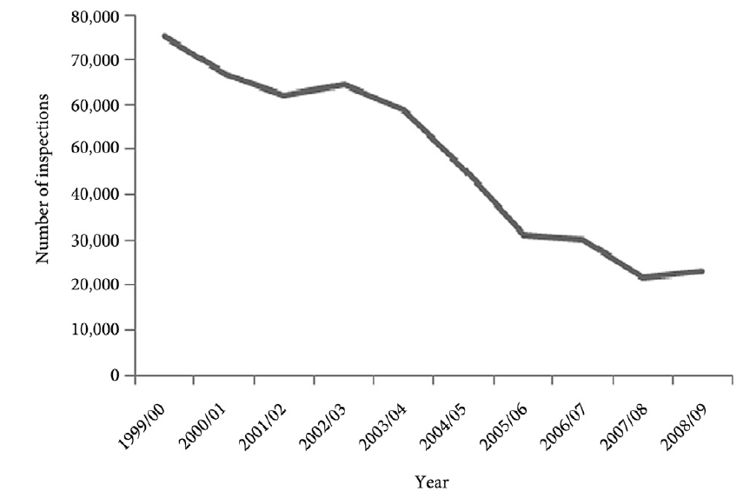
Decline in enforcement activity
Toombs, S & Whyte, D. (2012) Transcending the deregulation debate? Regulation and governance, 7, 61-79
IER Conference 2016
Liverpool | October 2016

Slide 8
Attacks on tripartite structure
Govt /media attacks on ‘elf and safety
HSE victims of its own acquiescence
Austerity agenda/cutbacks in inspection
Attacks on trade unions
IER Conference 2016
Liverpool | October 2016

Slide 9
Levels of engagement
HSE Board
Workplace/complaints inspections
Advisory Committees/Forums
IER Conference 2016
Liverpool | October 2016

Slide 10
HSE Decisions driven by:
Money
Politics
Relationships
Evidence/risks to health
IER Conference 2016
Liverpool | October 2016

Slide 11
Case study:
Sharps regulations
IER Conference 2016
Liverpool | October 2016

Slide 12
HSE Position on
Sharps regulations
Resistance
Reluctant acceptance
Support
IER Conference 2016
Liverpool | October 2016

Slide 13
How to change the HSE’s mind
Evidence
Media and political pressure
Pressing the right buttons
Coalition building
Building relationships
IER Conference 2016
Liverpool | October 2016

Slide 14
Complaints to the HSE
Breach of regulations
Pressing the right buttons
Risk to health and safety
Exhausted all other channels
IER Conference 2016
Liverpool | October 2016

Slide 15
Thank You
Any Questions?
Contact details:
IER Conference 2016
Liverpool | October 2016

