Slide 1
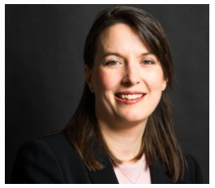
Employment Law in 2017: an overview
A talk by Paul Scholey
Senior Partner
Morrish Solicitors LLP
Slides by Corinna Ferguson
Notes:
1

Slide 2
A Year In Employment Law…..
Notes:
2

Slide 3
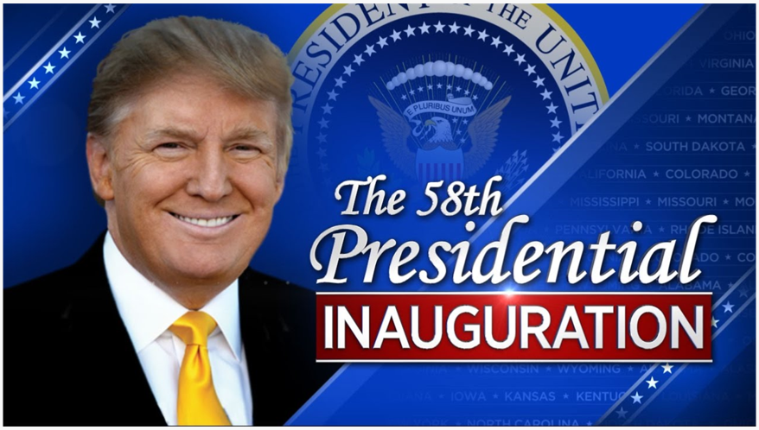
January
Notes:
3

Slide 4
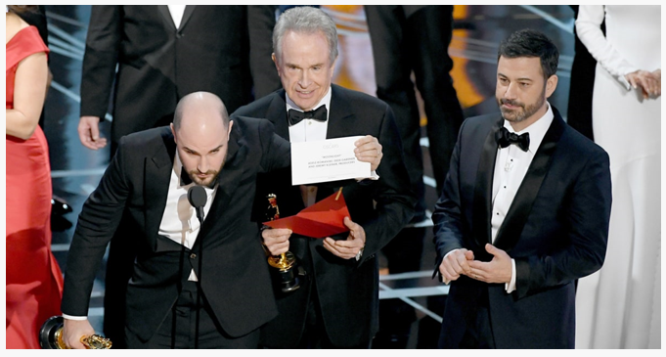
February
ET judgments go online: www.gov.uk/employment-tribunal-decisions
Pimlico Plumbers in the Court of Appeal [2017] EWCA Civ 51 – Mr Smith found to be a worker.
Notes:
4

Slide 5
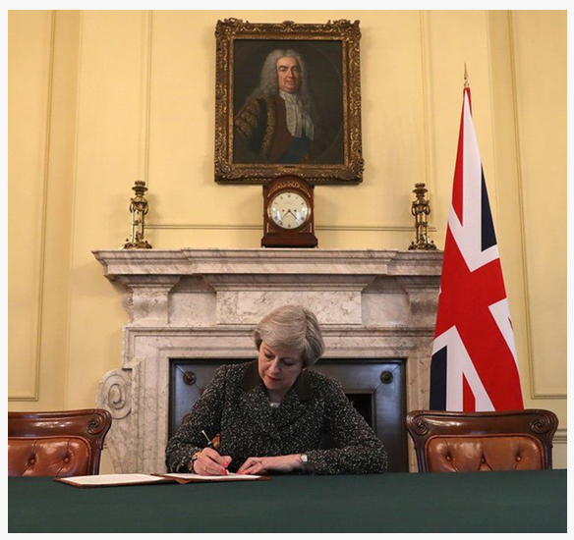
March
CJEU headscarf cases
C-157/15 Achbita v G4S: Headscarf ban not direct discrimination. Also unlikely to be indirect discrimination because justifiable on “neutrality” grounds.
Case C-188/15 Bougnaoui v Micropole: Wishes of customer do not constitute genuine occupational requirement.
Notes:
5

Slide 6
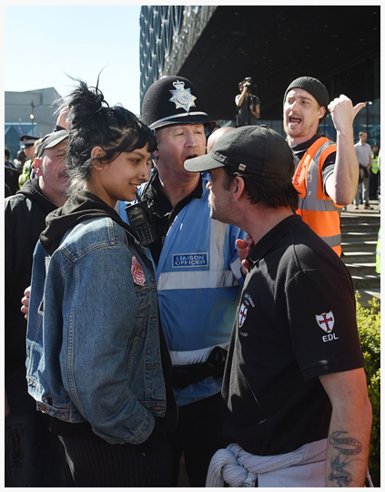
April
Essop & Naeem in Supreme Court [2017] UKSC 27: No need for C to show reason for statistical disparity. Essop remitted to ET; Naeem dismissed because pay scheme was justified.
Notes:
6

Slide 7
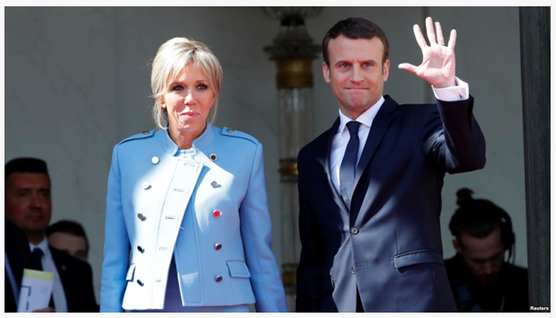
May
Hartley v King Edward VI College[2017] UKSC 39: Supreme Court finds in favour of teachers in dispute about calculation of a day’s pay for the purposes of deductions for industrial action.
Notes:
7

Slide 8
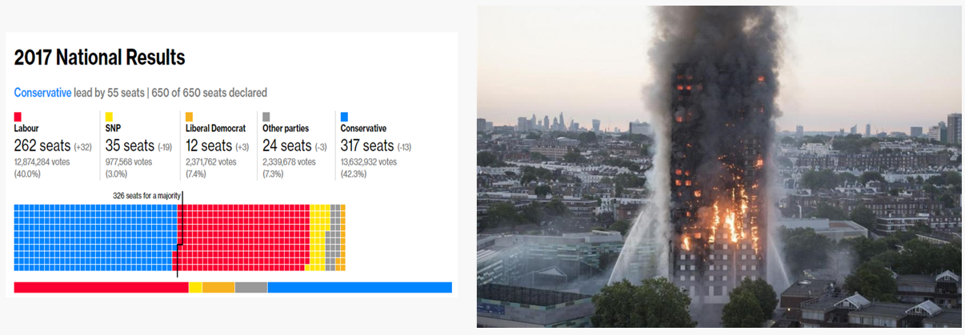
June
Notes:
8

Slide 9
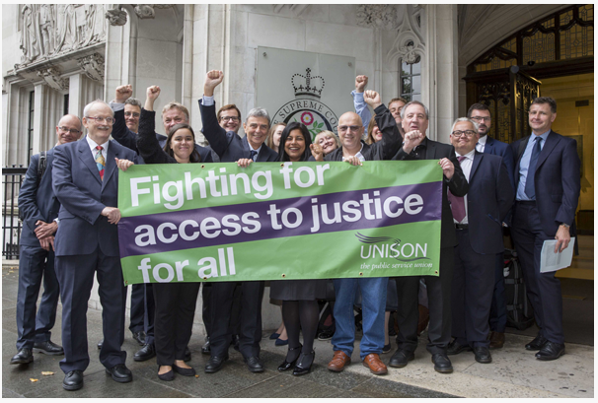
July
Chesterton [2017] EWCA Civ 979 in Court of Appeal on “public interest” test in whistleblowing.
Walker v Innospec [2017] UKSC 47: Supreme Court upholds equal pension rights for same sex marriages.
Unison judgment! [2017] UKSC 51: Supreme Court holds Fees Order effectively prevents access to justice and is therefore ultra vires. Refund scheme now in place.
Notes:
9

Slide 10
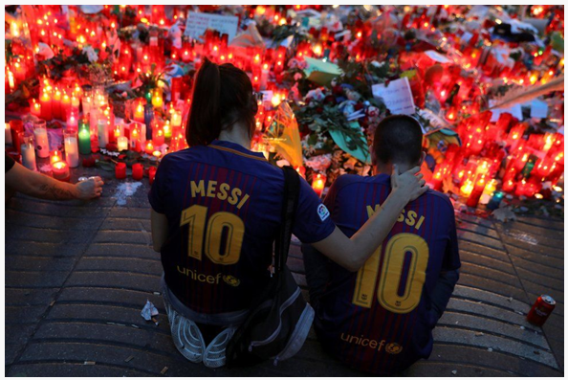
August
Dudley v Willetts [2017] IRLR 870: EAT holds voluntary overtime counts in calculation of holiday pay if sufficiently regular to be part of normal pay.
Efobi in EAT: changing the “shifting burden of proof”… until November…
Notes:
10

Slide 11
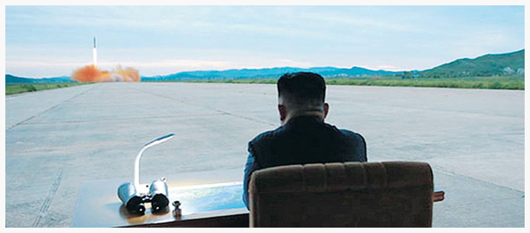
September
New “Vento” guidance for injury to feelings (NB Court of Appeal has now said this applies to all cases):
lower band (less serious cases): £800 to £8,400
middle band: £8,400 to £25,200
upper band (the most serious cases): £25,200 to £42,000
exceptional cases: over £42,000
Notes:
11

Slide 12
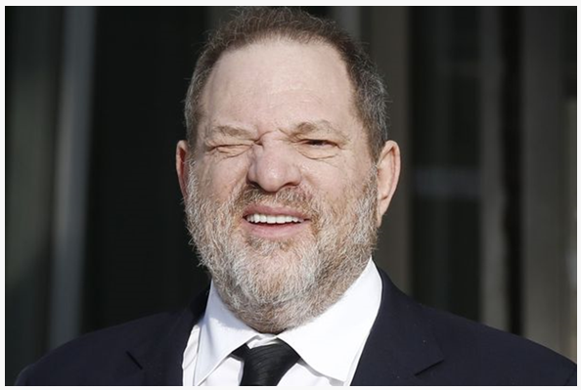
October
State and diplomatic immunity considered by Supreme Court.
Reyes v Al-Malki [2017] UKSC 61: diplomat employing domestic staff not immune from jurisdiction of ET.
Benkharbouche [2017] UKSC 62: state immunity act incompatible with Article 6 ECHR and Article 47 EU Charter. Discrimination complaints remitted to ET.
Notes:
12

Slide 13
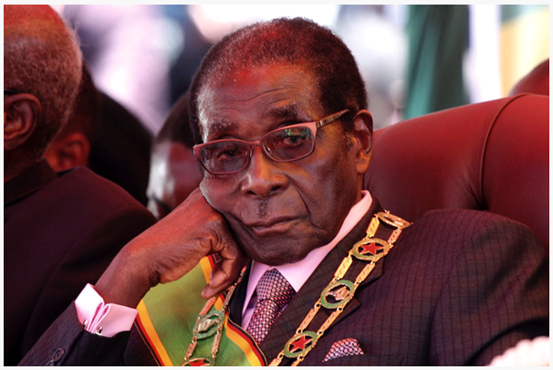
November
Two Supreme Court judgments confirming complaints of discrimination may be brought in ET against disciplinary bodies (P v Metropolitan Police; Michalak v GMC).
Uber loses its appeal to EAT UKEAT/0056/17/DA. Seeking leave to leapfrog to Supreme Court with Pimlico Plumbers.
Efobi reversed in Court of Appeal (Ayodele v Citylink [2017] EWCA Civ 1913).
Notes:
13

Slide 14
December
Kostal UK Ltd v Dunkley and others - inducements and collective bargaining.
Thoughts for the future…
Worker status – Supreme Court and implementation of Taylor Review.
Impact of fees.
Brexit………
Notes:
14

Slide 15
Any Questions ?
Notes:
15

Slide 16
Notes:
16

