Slide 1
Cases from the Workplace
A talk by Paul Scholey, Senior Partner
Morrish Solicitors LLP
To IER, January 2018
Notes:
1

Slide 2
Agenda
Formation of Contracts
Misconduct
Trade Union Membership
Social Media Stories
And more…

Slide 3
Rachel’s Story: A Facebook dismissal
Introduction
Residential Care home worker
21 years c/e
Music night
Pictures shared on Facebook
Notes:
3

Slide 4
Rachel’s Story 2
Picture contains resident with Down’s Syndrome
Breach of policy
Disciplinary
Offered demotion as alternative to dismissal
Significant pay cut
2 days to decide
Notes:
4

Slide 5
Social Media and fake news
Sept 17 US research (Pew Centre)
67% of US adults get some news on SM (+5%)
Only 24% believe the fact/fiction split is good
Benefits for journalism?
A 7% increase in paid subscriptions…

Slide 6
Social Media and The Law(yers)
Lucatello
Mahmood
SRA guidance…

Slide 7
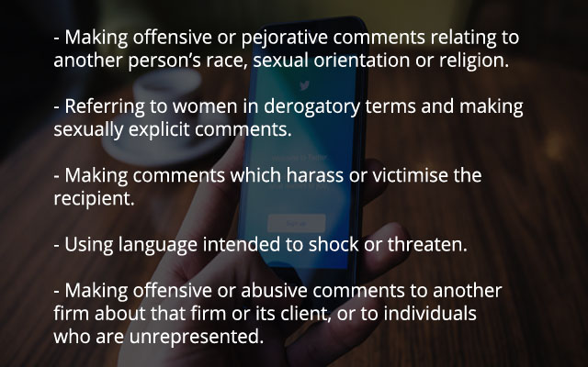
Social Media and The Law(yers)

Slide 8
Rachel’s Story 3
After 2 days…
R is off sick – stress and anxiety
“sorry you decided to accept dismissal”
Autumn 16 – ET lodged
Nov 16 – preliminary hearing set
Notes:
8

Slide 9
The Return of Barbulescu
Barbulescu v Romania 61496/08, ECtHR (GC)
Employee using business email account for private messages
Dismissed following monitoring
Knew of policy but not monitoring
2016 ECtHR decision
Now: Grand Chamber decision
Notes:
9

Slide 10
The Return of Barbulescu
Principles include:
Proportionality
Notice of monitoring
Extent of monitoring/degree of intrusion
Legitimate reasons
Availability of less intrusive methods
Safeguards?
Notes:
10

Slide 11
Rachel’s Story 4
Husband out of work sick
No reference – Rachel can’t find employment
Credit card debt
No legal representation (cf Respondent Council)
Full hearing: June 2017 (7 months post-PH)
Dec 16 offer
Notes:
11

Slide 12
Contracts: formation
Formalities:
An agreement (offer and acceptance)
Supported by consideration
An intention that it should be legally binding
Sufficiently certain
Notes:
12

Slide 13
Variation of Contracts
Recruitment – Vetting
Records of employment
Monitoring – where we will concentrate
Detailed provisions in relation to retention of health records
Notes:
13

Slide 14
Contracts: formation
Jeffrey Blue v Michael Ashley (2017)
Employee in informal meeting offered share price deal
£15 million on offer if share price hits £8
And it does…
Was there a contract?
Notes:
14

Slide 15
Contracts: formation
Factors included:
Setting
Purpose of meeting
Nature and tone of conversation
Commercial sense
Vagueness
Notes:
15

Slide 16
Rachel’s Story 5
By ET in June 2017 “breaking point”
No money in bank
2 days pre-ET R wants to call it a day
“I’ve had to watch my wife slowly falling apart”
The ET hearing
Notes:
16

Slide 17
“Mis”-conduct
J P Morgan Securities v Ktorza UKEAT/0311/16 (11 May 2017, unrep)
Employer’s rules re: trading practices breached
Dismissal for misconduct
ET considers “culpability”
The issue is “conduct” says EAT
Notes:
17

Slide 18
Trade Union membership
Jet2Com Ltd v Denby UKEAT/0070/17 (25 October 2017, Unrep)
S.137 TULRA - Meaning of “grounds related to union membership”
Jet2 Pilot and former BALPA member
Activities: “Outward manifestation of membership”
Notes:
18

Slide 19
Rachel’s Story 6
ET June 2017
7 weeks to wait for the decision
Findings: fairness generally; the time pressure issue
Remedy?
Notes:
19

Slide 20
Closing Remarks
An “at all times disquieting truth” of a pluralistic society is: “constantly proliferating new and ingenious forms of expression” (Erznoznik v City of Jacksonville 1975)
“We are at the frontier between physical and cyber spaces” (P Chadwick, 2017)
But outside the Unionised workforce there is no equality of arms in either space
Notes:
20

