Slide 1

Cuts and Privatisation in Teaching
Noel Hulse
Regional Officer, NUT NW Region

Slide 2

What’s happening today?
“Yes” vote: 91.7%
Turnout: 24.5%

Slide 3
Why?
“The Department for Education is being entirely disingenuous when it says that our action is about levels of pay. The NUT is taking strike action in response to the funding crisis in our schools, which is impacting on teachers’ terms and conditions and children’s education.

Slide 4
Why?
“The NUT is also highlighting the complete break-up of our education system into individual academies, which is resulting in a breakdown of teachers’ employment rights.

Slide 5
Why?
“Hard fought for entitlements such as sick leave and maternity/paternity rights are under attack. Meanwhile, pay systems are now being decided at school level.”
Kevin Courtney, Acting General Secretary

Slide 6
What do we want….?
Fund schools sufficiently to cover the growing staff costs imposed on them, such as increased National Insurance contributions.
Tell academies they must at least have regard to national terms and conditions.
Promise meaningful talks to look for a full resolution of the dispute.

Slide 7
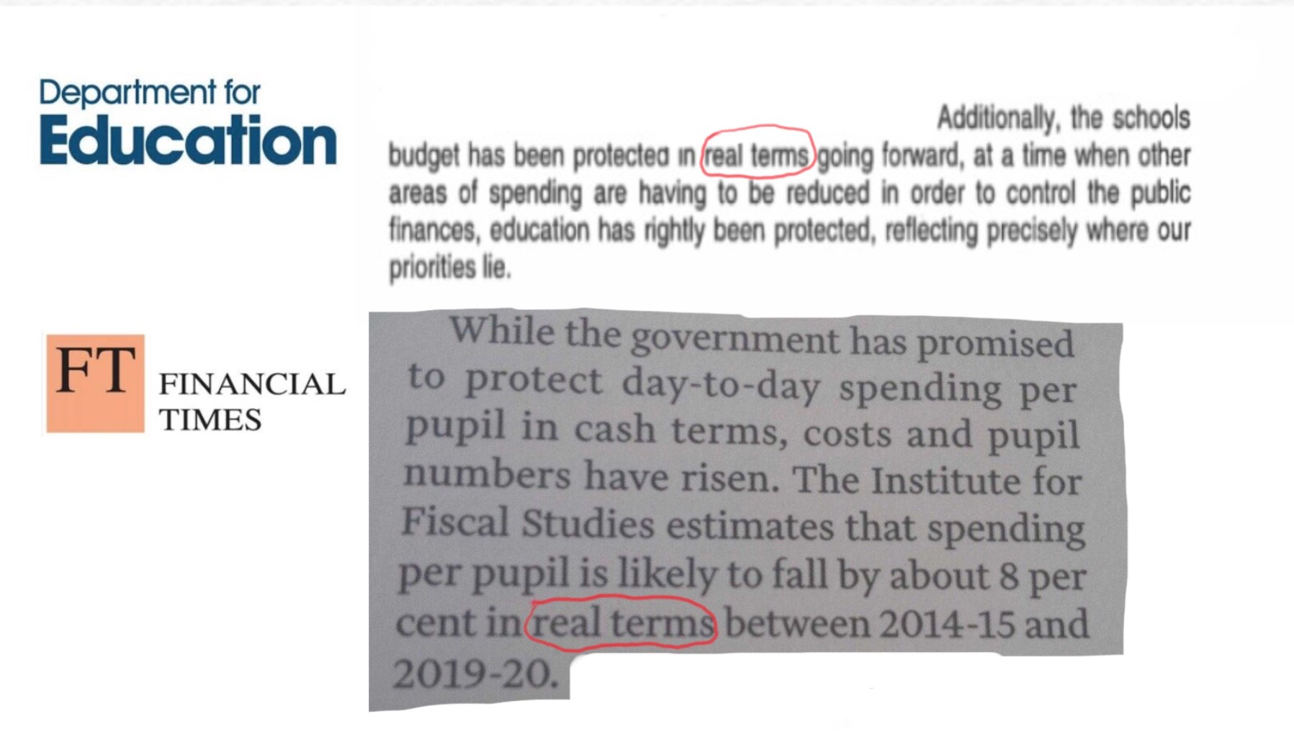
The funding crisis

Slide 8
More from the IFS
2010–11 to 2014–15: Even after allowing for the growth in pupil numbers … spending per pupil ..rose by 0.6% in real terms.
“We forecast that school spending per pupil is likely to fall by around 8% in real terms …between 2014–15 and 2019–20”
Spending per pupil fell by 3.6% in real terms between 1993 and 1997

Slide 9
Key cost increases
Average public sector pay settlement of 1% per year
Increased employer National Insurance Contributions from April 2016
Increase in employer pension contributions to the teachers’ pension scheme that came into force in April 2015.

Slide 10
The impact…
Headteachers had raised funding concerns with 75% of reps
60% said teaching posts would be lost in their schools
50% said classroom support staff posts had been or would be lost
60% reported existing or planned increases in class sizes

Slide 11
The impact…
65% reported existing or planned cuts in spending on books and equipment
50% reported existing or planned cuts in support to pupils with Special Educational Needs and English as an Additional Language

Slide 12
16-19 Funding
14% real terms cut 2010-11 to 2014-15
Funding per student still frozen in cash terms
Sixth Form Colleges pay VAT (£30 million p.a.)
Education Maintenance Allowances (£560m) replaced with Bursary Fund (£180m)
School and academy sixth form funding also cut

Slide 13
16-19 Funding - impact
By 2015, 72% of Sixth Form Colleges had dropped courses
81% had increased class sizes
More than a third think they will not be a going concern by 2020.

Slide 14
Wasted money…
£10 million written off by DfE from free schools and academies that never opened or forced to close (year ending March 2015 – Source: Schools Week)
Costs up to £1.9million on a single school
Free schools opened where there are surplus places
Notes:
Troubled economic times, improving education and skills is vital. So invest in it.
Education cuts never heal.
Spend wisely.
Gfiigures from DfE accounts . National Audit Office says gave an “adverse opinion on the truth and fairness” of the accounts.

Slide 15
Is education being privatised?
Academies can’t make profits – so how is that privatisation?
Academies just represent a small procedural change
Academies give freedoms to educators
Notes:
True – so far
Standards not structures
Not to individual teachers, not to schools joining MATs

Slide 16
What is privatisation?
“Transfer of assets, management, functions or responsibilities [relating to education] previously owned or carried out by the State to private actors“
Coomans and Hallo de Wolf “Privatisation of Education and the Right to Education” 2014

Slide 17
Academies & Free Schools
Publicly funded independent schools
Get money direct from government
Run by a trust which employs the staff
Some academies have sponsors
Set own pay & conditions
Don’t have to follow the national curriculum

Slide 18
Academies & Free Schools
Who runs them?
What is their motivation?
How are they accountable?
Notes:
Range of sponsors:
Faith groups - churches, Oasis, UL
Businesses - Harris, Co-op
Universities
FE colleges
Stand-alone
Education “leaders” - Bright Futures
Stand alones take over others

Slide 19
Educational Excellence Everywhere
Every school an academy
Most in Multi-Academy Trusts – you can never leave
End to national pay & conditions
End to Qualified Teacher Status as we know it
Notes:
Actors = not Benedict Cumberbatch
Religious institutions
Companies
Non-governmental organisations
About accountability
Have always been a private school sector.

Slide 20
Schools for profit?
Nicky Morgan: “[For profit] is something I am happy to have lots of further advice and emails on. I suspect that most people may not be very keen on it, but it’s something….well you’d have to think very carefully.” (TES 2014)
Michael Gove: “There are some of my colleagues in the coalition who are very sceptical of the benefits of
profit. I have a very open mind.”

Slide 21
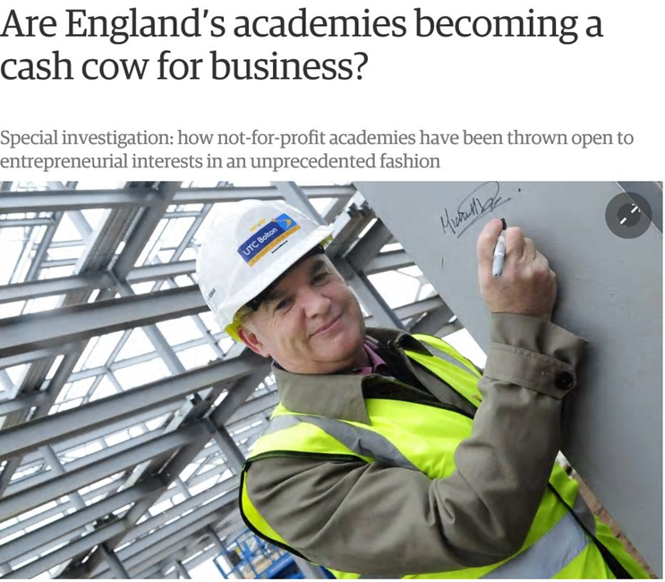
Making money from schools
The Guardian, June 2016

Slide 22
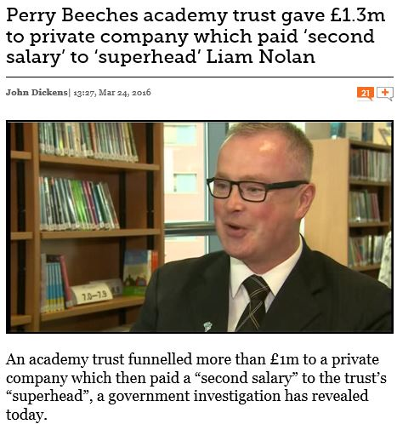
Making money from schools
Schools Week, March 2016

Slide 23
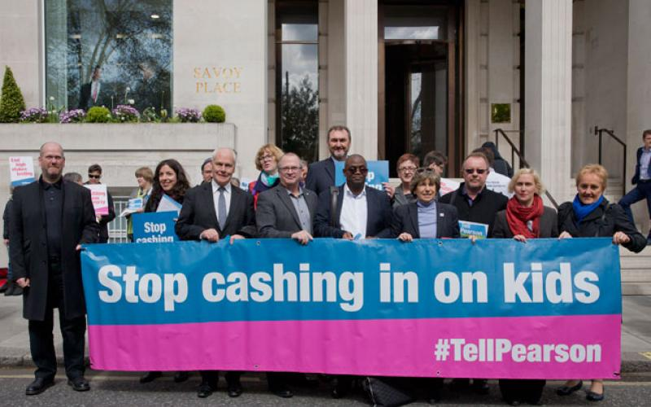
Making money from schools

Slide 24

The GERM
Global Education Reform Movement
Pasi Sahlberg: Finnish Lessons

Slide 25
The symptoms
Competition
Choice, parents as consumers
Privatisation
Academies, market philosophy, autonomy
Standardisation
Core curriculum, standardised tests, data
Accountability
Inspection, observation, league tables
Incentives
Performance related pay

Slide 26
An alternative narrative
They say
We say
Competition
Privatisation
Standardisation
Accountability
Incentives
Partnership
Community
Child Centred
Professionalism
Collaboration

Slide 27

A response
Increased focus on the workplace
Empower members and reps
Engaging with the community

Slide 28
www.teachers.org.uk

