Slide 1
Free Movement and Workers’ Rights
Prof Michael Doherty
Maynooth University,
IER; Has social Europe disintegrated?

Slide 2
The European Economic Community
EEC Treaty (Treaty of Rome)- clear economic focus;
Customs union (abolish internal levies/import restrictions )
Four freedoms- goods, workers, services, capital
Competition law (eliminate trade barriers)
Regulate state intervention in market

Slide 3
The European Economic Community
Title on Social Policy- weak- e.g. Art 117EEC (now 151 TFEU)- MS agree upon the need to promote improved working conditions and an improved standard of living for workers… Social advances would flow from economic efficiency

Slide 4
The European Union
Maastricht-Treaty on European Union (TEU) 1992- Art 2EC (now Art 3TEU)- a high level of employment and of social protection, the raising of the standard of living and quality of life, and economic and social cohesion and solidarity among Member States

Slide 5
The European Union
Lisbon-Treaty on European Union (TEU) 2009- The Union shall establish an internal market. It shall work for the sustainable development of Europe based on balanced economic growth and price stability, a highly competitive social market economy, aiming at full employment and social progress
Charter of Fundamental Rights of the EU (collective rights, fair working conditions, social security/assistance)- ‘civilising’ the internal market

Slide 6
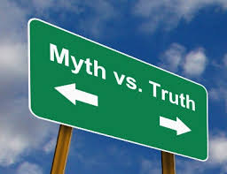
Some numbers…
The % of EU citizens exercising free movement rights:
2004: 2%
2016: 3%
The % of non-EU migrants in most of the high-wage MS is higher than EU migrants (except in Ireland)

Slide 7
Eurostat 2013-% of free movers in the total population

Slide 8
Free movement and Workers’ Rights
Free movement and equal treatment
The internal market and free movement of labour
Posted workers and public procurement
Free movement and social assistance

Slide 9
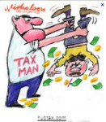
1. Free Movement and equal treatment
Equal treatment and economics:
Those who move to another MS to work are entitled to equal treatment in employment; and ‘social and tax advantages’
equal treatment should be understood as protection for both those who move and those in the host state
Equal treatment, not only in wages and working conditions, but also in terms of social security and assistance is necessary
Equal treatment and social solidarity

Slide 10
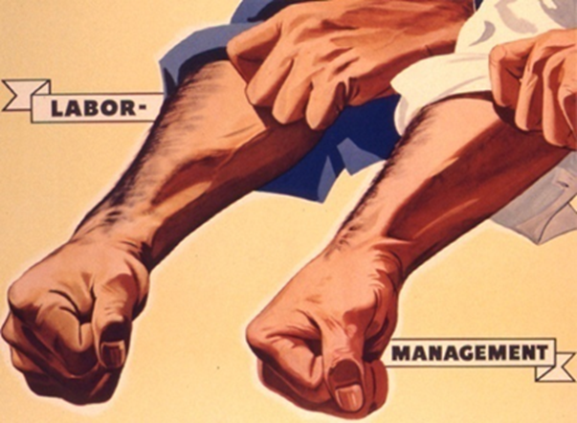
2. The Internal Market & Free Movement of Labour
Internal market and free movement of labour (with the accompanying rights) must be complementary (not in opposition)
Granting the right to free movement creates an inextricable link between the internal market and European societies.

Slide 11
2. The Internal Market and Free Movement of Labour
Danger that internal market law is a matter for the EU while social and labour rights are ‘relegated’ as an issue for the MS

Slide 12
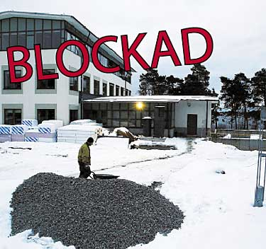
3. Posted workers & public procurement
Without protecting labour standards of workers sent temporarily to other MS by their employer to provide services, neither the posted workers nor workers or employers in the home states can be guaranteed a level playing pitch.
Posted workers denied equal treatment rights; effectively ‘normal’ free movement rights are suspended in favour of employers’ freedom to provide services.

Slide 13
3. Posted workers & public procurement
EU Court has severely restricted the rights of trade unions, and State authorities via public procurement processes, to enforce labour standards (going beyond the statutory minimum) against service providers established in other EU MS
Collective bargaining and industrial action are seen as infringing the rights of service providers to operate across borders….

Slide 14
3. Posted workers & Public Procurement
Do limitations on the fundamental rights to undertake collective bargaining go beyond what is required to allow the free functioning of the market in cross-border services?
Note sectoral influences, precarious work, agency work….

Slide 15
4. Free movement and social assistance
Since the 1970s, the EU has tried to ‘coordinate’ social security for free moving workers
worker is only subject to one social security system
workers do not lose social security benefits by virtue of exercising free movement rights. (Reg 883/2004; 987/2009).

Slide 16
4. Free movement and social assistance
Non-economically active citizens (cannot be a burden on the host state)
Article 24(2) 2004/38- the host MS is not obliged to provide ‘social assistance’ in the first 3 months
Guards against ‘Welfare tourism’
Dano case (333/13)- equal treatment is only available to those residing lawfully in a MS in line with Dir 2004/38 (must demonstrate a level of ‘integration’ in the host MS).

Slide 17
4. Free movement and social assistance
Spill-over to job-seekers and former workers (need a ‘stable socio-economic link’ to the host MS)?
Workers:
MS authorities may misclassify someone as a ‘non-worker’ (note ‘informal’ work)
Migrants are often unaware of the correct procedures
Work records in the home state are not always considered (migrants may provide insufficient information)
MS authorities may have a desire to ‘defend’ the national coffers and not be a soft touch

Slide 18
4. Free movement and social assistance
This is not an abstract discussion… Posted Work and Social Security/ Judicial ‘enforcement’
RTÉ Radio 1: Documentary on One - The Case That Never Was (http://www.rte.ie/radio1/doconone/2015/1204/751206-the-case-that-never-was/)

Slide 19
5. Conclusion
The level of movement is still very small; but public opinion in some MS sees it as a ‘flood’
Fears of a decline in wages/living standards are common, but political reaction may make the decline more likely
EU migrants might, initially, accept lower standards BUT equal treatment will most likely result in them adapting to the standards of the host MS.
Unequal treatment will likely mean social dumping, resentment and hostility

Slide 20
Is a Eurovision of workers’ rights possible…?

