Slide 1
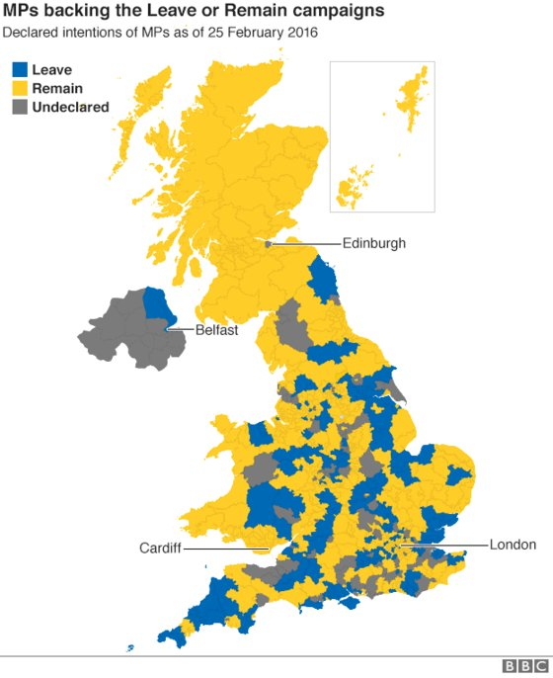
Scotland & Brexit:
Independence in Europe or Economic Democracy ?
The SNP, Independence and the EU
Misunderstanding the Brexit vote in Scotland
The Needs of the Scottish Economy
The Single Market or Economic Democracy ?

Slide 2
“Caledonian Antisyzygy”
Warning
Combining Contradictory elements
Scotland is unpredictable

Slide 3
The rise in the Independence vote
House of Commons Library research paper 14/50
2014 referendum vote: high correlation areas worst deprivation
Scottish Social Attitudes Survey: economic grievance driving independence attitudes 2012-2014

Slide 4
Growth of Euro-Scepticism in Scotland
Stay and “reduce powers” combined:
2005 53 per cent; 2016 67 per cent
Scottish Social Attitudes Survey

Slide 5
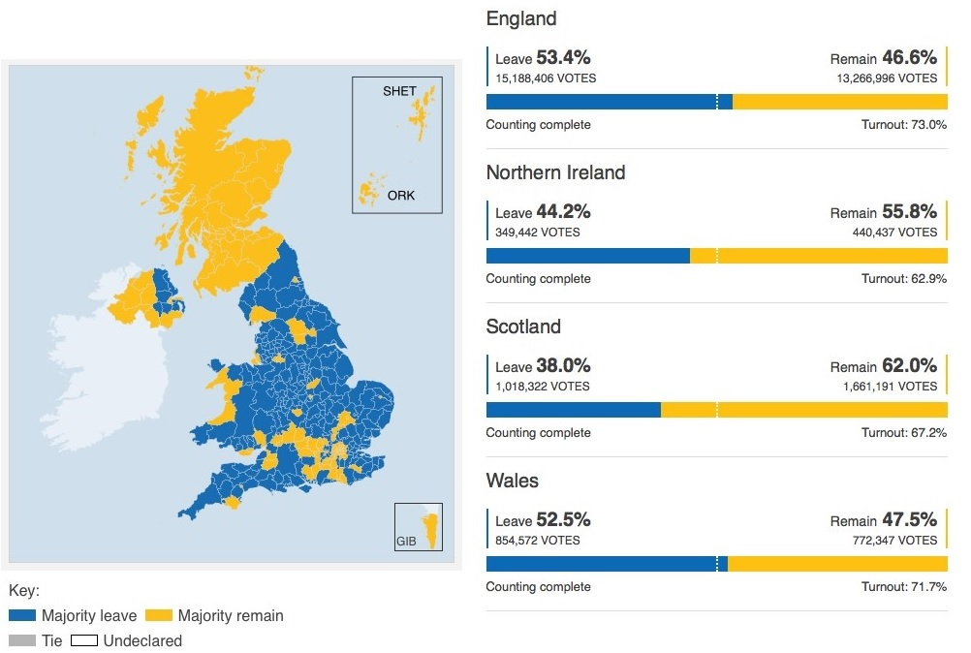
2016 Scotland votes
62 per cent Remain

Slide 6
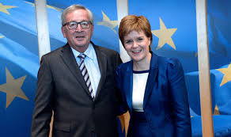
Scotland’s Right to Remain
Leading Scotland: Leading for the EU
2017 Election Manifesto
“we will demand a place for Scotland at the Brexit negotiating table and the inclusion of the case for our place in the Single Market in the UK’s negotiating remit.”
36 per cent of SNP voters voted Leave in 2016

Slide 7
2017 Election
SNP 36 per cent minus 14 per cent
Con 28 per cent plus 13 per cent
Lab 27 per cent plus 2.6 per cent
Turn-out 64 per cent minus 5 per cent
Turn-out UK 69 per cent plus 3 per cent

Slide 8
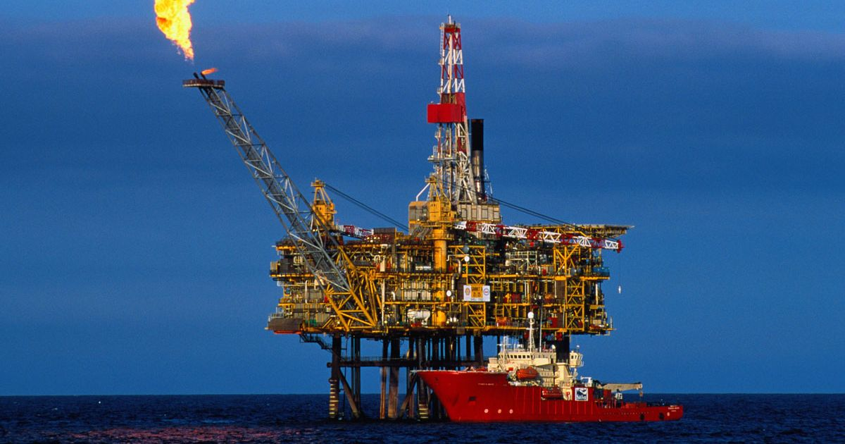
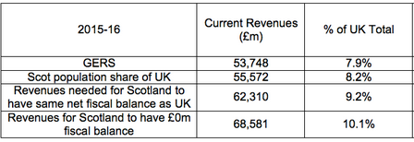
From ‘Independence in the EU’ to Single Market membership
GOVERNMENT EXPENDITURE AND REVENUE SCOTLAND GERS

Slide 9
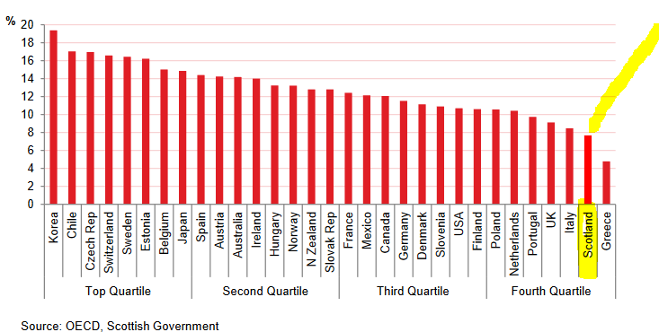
Scotland’s Economy Business Investment
Manufacturing as per cent GVA
20.5%
2015 8.6 %

Slide 10
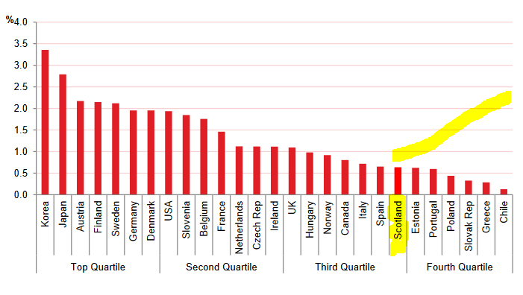
Scotland’s Economy: Research and Development

Slide 11
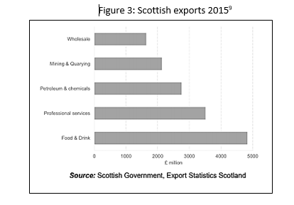
Scottish Exports
Exports as per cent of GDP
Germany 44 per cent
Sweden 43 per cent
UK 24 per cent
Scotland 12 per cent
Scottish internat exports
EU £12B
Total £28B
Exports rest of UK £50B

Slide 12
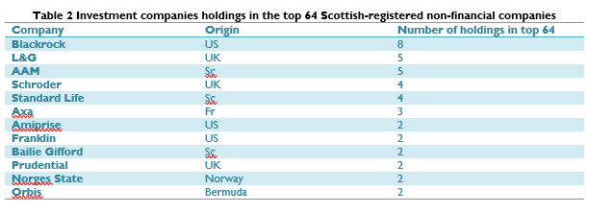
Financial control and extraction of ‘Shareholder Value’
Foreign owned enterprises as per cent GVA
UK 27.5 %
Scotland 34.6 %
Bank of England, Who Owns a Company ?, 2015.

Slide 13
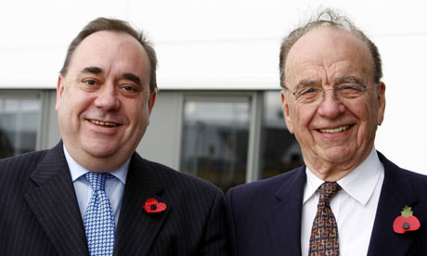
Scotland: a small country with a fragile economy highly exposed to corporate power
SNP a principled party.. its commitment is to independence
Economic policies neo-liberal
Powers to reduce corporation tax and attract ‘high-worth’ individuals
Single Market: Edinburgh financial sector: food processing - short-term

Slide 14
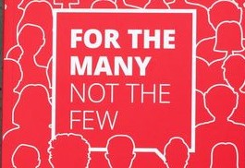
Labour Party Manifesto 2017
Public sector Investment Bank: use pension savings for long-term investment: de-financialise the productive economy
Public ownership – transport, energy, post office and communications
State aid for struggling firms and strategic industries
Restore ability of local government to develop own service provision: housing; local energy – integrated regional production centres together with state aid and regional direction of industry
Public Sector procurement (NHS, infrastructure) to require minimum labour standards and local sourcing
Progressive federalism: national and regional economic powers

Slide 15
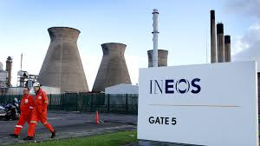
SNP and the Single Market: blocking economic democracy
Single Market
Competition Rules: no state aid, no public sector monopolies, no direction of capital
Procurement Rules: services must go to universal contract; can’t legislate for collectively bargained wages or exclusion of black listing companies
Trade Treaties: CETA and state investor dispute clause: compensation loss of profit for denial of access to market
Labour Manifesto: access to, but not membership of, Single Market

Slide 16
ADDITIONAL SNP vote since 2012 a populist protest vote – not ideological support for nationalism: anger at austerity and remote government
The SNP’s stress on EU a) electorally damaging to itself b) ultimately damaging to Scottish Economy
Single market = neo-liberal exposure to corporate power
The 2017 Labour election manifesto: a framework for economic democracy
Conclusions

