Slide 1
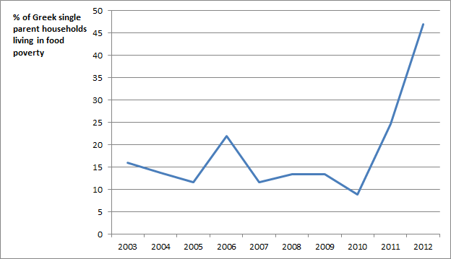
EU Austerity
Economic Causes – Economic Consequences
IER
Conference
9 February 2016

Slide 2

Overview
CAUSES
the neo-liberal assumptions of the 1986 Single Europe Act and subsequent treaties
the contradictions between these assumptions and the real world
the resulting financial crisis and the subsequent political use of the crisis
CONSEQUENCES
Increasing inequality of power between capital and labour and forcing down the wage share in national income
Increasing inequalities of development between states within the EU
Exporting crisis to the rest of the world

Slide 3
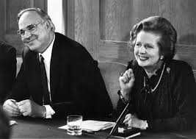
Origins
1986 Single European Act
Neo-liberal Assumptions
National Objectives
Competition will maximise growth
Free movement of capital, labour, goods and services: end to public monopolies
Governments must not interfere with demand
An end to Keynesian pump priming; unemployment maximises labour competition
Cecchini Report: 5 million jobs

Slide 4

Contradictions between assumptions and the real world
Inequality of productive capacity across the EU
Country | Percentage increase in German exports between 1998 and 2006 to | Percentage increase in German imports from
Greece | 126 | 19
Ireland | 120 | 15
Portugal | 53 | -2
Spain | 123 | 56
Table 1 Percentage increase in German imports and exports (by value) 1998-2006:
based on euros at current value (selected countries)
Source: Eurostat, External and Intra European Union Trade: Statistical Yearbook 2008 edition: Table 5B^{[i]}

Slide 5
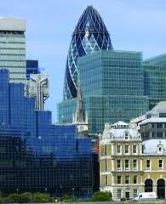
Contradictions
Public spending restricted;
Bank borrowing not
Country | Total exposure dollars billions
Germany | 733
France | 823
Japan | 132
UK | 453
US | 236
Table 2 Exposure of banks to debt in
Greece, Ireland, Italy, Spain and Portugal 2009 Q3

Slide 6

Contradictions
Strength of collective bargaining
across the EU
Sole focus of EU reform activity
Lisbon Programme 2000
How to create flexible and competitive labour markets: reduce ‘disincentives to work’ and ‘early exit from employment; poverty reduction linked to employability
Updated Lisbon Programme 2005/EU 2020
Services Directive 2006: posted workers
ECJ judgements 2007-08: Viking, Laval, Ruffert, Luxemburg
Modernising Labour Law White Paper 2007: Flexicurity

Slide 7
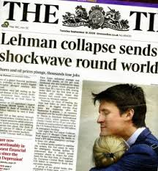
EU Crisis
Combines economic imbalance with City of London leverage
Table 3 Gearing of banks 2009 Q3
Country | Short-term funding | Bank capital to assets
Germany | 30 per cent assets | 4 per cent
France | 26 | 5
UK | 23 | 7
US | 19 | 10

Slide 8
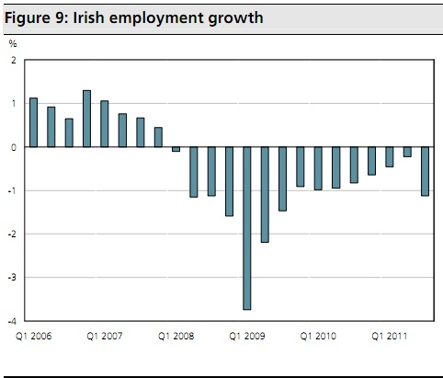
Crisis
A neo-liberal solution
No EU transfer funding
No monetary boost to demand
Bank funding reversed
Governments made liable for banking debts: immediate payment
Reform Programmes mandate attack on collective bargaining and labour rights, on state sectors.

Slide 9
Consequences
Forcing down the Labour Share of Income:
labour flexibility; labour mobility
Country |  | Unemployment 2012 | Worker Compensation as per cent of GDP 2008 | Worker Compensation as per cent of GDP 2014
Britain |  | 7.9 | 52.2 | 49.2
Germany |  | 5.4 | 48.5 | 50.9
Ireland |  | 10.7 | 43.4 | 37.4
Greece |  | 24.5 | 34.0 | 32.8
Spain |  | 24.8 | 50.1 | 47.1
Portugal |  | 15.8 | 46.8 | 44.2

Slide 10
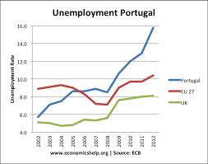
Consequences
Forcing down labour share 2
PORTUGAL NATIONAL REFORMPROGRAMME 2015
“To encourage job creation in open-ended contracts and address duality, severance payments for permanent contracts have been reduced, while the definition of fair dismissals has been eased. Working time has become more flexible to contain employment fluctuations over the cycle, accommodate differences in work patterns across sectors and firms better, and enhance firms’ competitiveness.
To facilitate wage adjustment, measures have been taken to increase scope for bargaining at firm level. Unemployment insurance benefits have been revised to increase incentives for a rapid return to work, while guaranteeing a sufficient level of protection and easing eligibility
The number of sectoral collective agreements fell from 172 in 2008 to 36 in 2012, while the number of extensions fell from 137 to 12 in the same period. Firm-level collective agreements also declined considerably. The number of employees covered by collective agreements fell from almost 1.9 million in 2008 to some 225,000 in 2014.”

Slide 11

Consequences: Impact on uneven development: investment, growth
Country | Percent change in gross fixed capital investment: 2012 compared with 2008 | Unemployment 2012
Britain | -0.4 | 7.9
Germany | +6.3 | 5.4
Italy | -15.0 | 10.7
Greece | -61.4 | 24.5
Spain | -36.2 | 24.8
Portugal | -35.0 | 15.8
Table 6 Annual increase in GDP: Germany and the 19 country Eurozone
Area | 2008 | 2009 | 2010 | 2011 | 2012 | 2013 | 2014
Germany | 1.1 | -5.6 | 4.1 | 3.7 | 0.4 | 0.3 | 1.6
Eurozone | 0.5 | -4.5 | 2.1 | 1.6 | -0.9 | -0.3 | 0.9

Slide 12

Consequences: ownership of assets
Reform Programme privatisation: Portugal
Sale of government shares in
Galp Energias,
Energias de Portugal,
electricity distributor REN,
paper firm Inapa,
the Viana do Castelo shipyards,
airline TAP Portugal,
Portugal Airports,
the CTT post service,
BPN bank,
the insurance division of Caixa Geral de Depositos
Government's activities in the rail freight sector.
Reform Programme privatisation: Greece
66 percent of Desfa, a gas distribution and liquid gas processing firm
up to 35 percent of oil refinery and petrol distribution firm Helpe
17 percent of electricity distributor PPC;
65 percent of gas distributor Depa.
14 regional airports, to be sold to German firm Fraport for €1.2 billion
67 percent of the Piraeus Port Authority
67 percent of the Thessaloniki Port Authority
100 percent of national rail and bus service providers, Trainose and Eessty
30 percent of Athens International Airport
a 648 km-long motorway, which connects northern Greece to Turkey.
90 percent of Elta, the Greek postal service
60 per cent of OTE, the Greek phone service provider already 40 percent-owned by Deutsche Telekom.

Slide 13
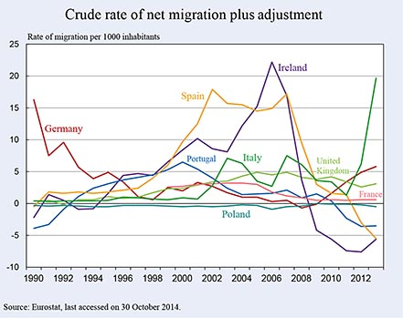
Consequences
Labour Mobility
Baltic States
Sommers and Woolfson, Contradictions of Austerity, 2014
“Internal devaluation”
Wages reduced to < quarter Sweden
Lithuania loses up to a third of most skilled and educated workforce post-2008

Slide 14
2012 Eurozone crisis:
neo-liberalism reinforced
2012 Fiscal Compact: intensified austerity
Max deficit 0.5 per cent GDP; max debt 60 per cent; mandatory reduction by 5 per cent a year
European TUC
‘running as a red line through the programme of Economic Governance is the idea of turning wages into the main instrument of adjustment: currency devaluations (which are no longer possible inside the Euro Area) are to be replaced by a devaluation of pay in the form of deflationary wage cuts. To achieve this wage “flexibility”, labour market institutions which prevent wages from falling are perceived as being a “rigidity” which should be eliminated.’

Slide 15
Economic Consequences
Exporting crisis to the rest of the world
UN Commission on Trade and Development Annual Report 2012
the European Union’s policy of ‘unconditional austerity’
‘is suffocating the return to sustainable economic growth’
‘a further deterioration of economic conditions in Europe cannot be excluded’.
’An even greater problem for global recovery is Europe’s increasing dependence on exports. The whole region is, in effect, trying to export its way out of the crisis. This could exert an enormous drag on overall global growth and worsen the outlook for many developing countries.’
Year | Balance between imports and exports
2010 | 178 billion euros
2011 | 170
2012 | 115
2013 | + 48
2014 | + 18
Balance of trade between the EU and the rest of the world (euros billions)

Slide 16
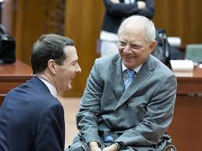
Conclusions
EU not a transfer union – cross country transfers
would contradict neo-liberal assumptions
Crisis has radically weakened position of labour –
and internal demand
Uneven development intensified
ECB QE fed into banks not economies – probably worsened burden of corporate debt
Exporting crisis has contributed to global slowdown, collapse of commodities prices and, in part, flow of migration into EU
Fatal combination of national interests: dominance of production by one country within increasingly financialised structures of ownership and control matching interest of another.

