Slide 1


Employment Law Update
#ierelu
2nd December, 2015
The Adelphi Hotel, Liverpool
www.ier.org.uk

Slide 2
Social media: reloaded
Paul Scholey.
Morrish Solicitors
#ierelu
2nd December, 2015
The Adelphi Hotel, Liverpool
www.ier.org.uk
www.ier.org.uk

Slide 3

Social Media and The Law: Reloaded
Paul Scholey
Senior Partner
Head of Employment Rights
Morrish Solicitors LLP
November 2015

Slide 4
Agenda
New statistics
New cases
Any new conclusions?

Slide 5
A Question of Scale
Facebook 1.3 billion March 14 1.49 billion MAUs (Aug15)
Instagram 400m MAUs (Aug 15)
But QQ is catching up (829m, Jan 15)

Slide 6

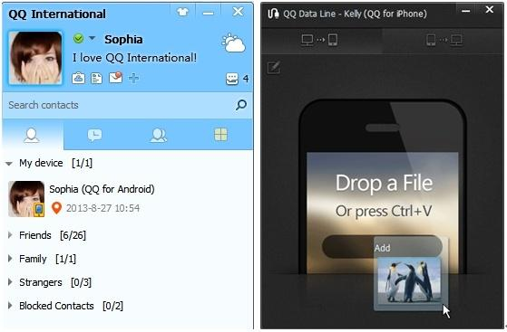
A Question of Scale

Slide 7
Who, What & When?
25 to 34, at 29.7% of users, is the most common age demographic
Facebook users are 76% female and 66% male
4.5 billion likes generated daily as of May 2013
1 – 3pm midweek is top posting time

Slide 8
General Principles
Employment Rights Act 1996 Section 98(4)
A potentially fair reason +
Fairness - “in accordance with equity and the substantial merits of the case”
The “band of reasonable responses”
The importance of fair procedures

Slide 9
ACAS Guidance
Contrast serious reputational attacks and “letting off steam”
Nature of Job & Seniority
Seriousness of misconduct
Nature of organisation
Terms of any policy
Disclosure of confidences
Risk of reputational damage
Impact on job
Mitigating factors

Slide 10
New cases
Williams v Leeds Utd FC
Employee under notice of redundancy
Employer trawls email account
Dismissal on basis of emails 5 years old?

Slide 11
Texts
Mason v Huddersfield Giants
Text sent by 3rd party
Wrongful Dismissal?
Cf. unfair dismissal?

Slide 12
Revenge Porn
Anecdotal evidence
Secondary School Teacher
Victim of revenge attack - photos posted to FB
School approached by parents – threat of dismissal
Some other substantial reason?

Slide 13
Texts & Consistency
MBNA v Jones (30.10.15)
Work function at Chester Races
A punch followed by threatening texts
Dismissal vs FWW?

Slide 14
Facebook
British Waterways v Smith (Aug 15)
Remarks made about BWB on FB lead to internal mediation
Manager digs out posts 2+ y/o including remarks about drinking on standby
Permissible to rely on old (known) posts to dismiss?

Slide 15
Facebook
Trasler v B&Q
Facebook criticisms of the employer
Threatening? Gross misconduct?
Contribution?
Contrast with:

Slide 16
Facebook
Weeks v Everything Everywhere
Facebook again
Work, the Circles of Hell, and reputational damage
Threats towards fellow colleague who tipped off the employer

Slide 17
Reputational Risk: factors
Consider:
How serious was the disclosure?
How many people saw it?
Who saw it?
Were there complaints?
Was the employer’s identity clear?
Was confidential information disclosed?

Slide 18
Facebook – devil in the detail
Blue v FSA
Joining in on others’ FB exchange regarding hitting a colleague:
“Aye right, i wish.”
Whether outside the band of reasonable responses

Slide 19
Summarising the approach?
See e.g. Lake v Amey (2015)
A reluctance to set special principles in social media cases
But the authorities are becoming clearer as to the sort of factors being taken into account
See the Lake summary on IER’s website

Slide 20
End
Social Media and the law will return…

Slide 21
TUPE & Collective Issues
Dominique Lauterburg.
MMU
#ierelu
2nd December, 2015
The Adelphi Hotel, Liverpool
www.ier.org.uk
www.ier.org.uk

Slide 22
Protecting workers’ rights to organise together
Hannah Reed.
TUC
#ierelu
2nd December, 2015
The Adelphi Hotel, Liverpool
www.ier.org.uk
www.ier.org.uk

Slide 23
Some Common questions on shared parental leave
Victoria Webb.
Old Square Chambers
#ierelu
2nd December, 2015
The Adelphi Hotel, Liverpool
www.ier.org.uk
www.ier.org.uk

Slide 24


Slide 25

Some Common Questions on Shared Parental Leave
Victoria Webb
Old Square Chambers
IER Employment Law Update, 11 November 2015
London

Slide 26
Shared Parental leave: resources
ACAS guidance, templates
BIS technical guidance
http://www.yesslaw.org.uk/sharedleave/

Slide 27
What hasn’t changed?
No reduction in maternity leave rights: birth mother can take OML plus AML up to 52 weeks
No reduction in adoption leave rights (in fact, improved: day 1 right, pay harmonised with SMP)
Ordinary Paternity Leave of one or two weeks
Unpaid parental leave remains (though now available for all children up to 18)
Notes:
DEFAULT POSITION REMAINS OML AND AML / ORDINARY ADOPTION LEAVE ANDADDITIONAL ADOPTION LEAVE

Slide 28
What is different about Shared Parental Leave?
“Opt in” to system IF eligible
Flexible way of sharing statutory leave and pay
Simultaneous, ‘chunks’ of leave, (almost) any time in first year
APL abolished, OPL remains but only can be taken if no SPL taken
Notes:
OPT IN IF ELIGIBLE
no increase in total amount of statutory leave and pay available
KEY WORD FLEXIBILITY
UNDER OLD SYSTEM MOTHER RETURNING TO WORK AFTER 20 WEEKS LOST REMAINING LEAVE and pay
- REQUIRED HER TO RETURN TO WORK IN ORDER FOR PARTNER TO TAKE LEAVE
- HAD TO BE AFTER FIRST 26 WEEKS
NOW CAN TAKE LEAVE ANY TIME AFTER BIRTH / ADOPTION SAVE FOR FIRST 2 COMPULSORY WEEKS
- partners CAN TAKE LEAVE and pay SIMULTANEOUSLY
CAN TAKE IT IN CHUNKS

Slide 29
Shared Parental Leave: overview
“Leave” Regs (SI 2014/3050), “Pay” Regs (SI 2014/3051) and “Curtailment” Regs (SI 2014/3052)
52 weeks: minus either amount of maternity leave taken, or weeks of maternity pay/maternity allowance used
during first year following birth / adoption
Keeping in touch days (“SPLiT”)

Slide 30
Shared Parental leave: overview
Shared between two parents – defined
Both individuals must satisfy criteria in order to opt in
Eligibility tests for leave and pay different
employment protections (right to return to same/other suitable role, redundancy, non-detriment) apply as with other forms of statutory leave

Slide 31
Eligibility: for person taking leave
Must have at date of birth/placement for adoption main responsibility for child (apart from other partner)
26 weeks’ employment prior to 15th week before birth/notification of adoption match – not day 1 right
Complied with formalities (including two-stage notice – see leave Regs)
Needs partner to meet a different eligibility test
Notes:
Where gets complicated.
Primarily because while phrase “shared parental leave” suggests both parents are planning to take leave, isn’t necessarily so.
Ie mother may decide to come back to work month 4, work 2 months, then take 2 months SPL then back to work, and her partner not take any SPL at all.
All sorts of permutations of eligibility, situations – death, termination of employment
Resources available – splash website
The person taking leave must be an employee. self-employed person can’t take SPL, though may take SPL pay if eligible
26 weeks? Means employed when pregnancy began
Complied with formalities –
if birth mother must have been entitled to maternity leave ie she complied with requirement to give notice of pregnancy.
And if birth mother must have informed employer she is curtailing her SML and SMP
And formalities in respect of SPL ie notice, requests for evidence

Slide 32
Eligibility: for partner of person taking leave
at date of birth/placement, main responsibility for child, (apart from other partner)
worked on an employed or self-employed basis in 26 of the last 66 weeks
meets earnings threshold test (must have earned at least £30 per week on average for 13 of those weeks)
if this other person is mother/main adopter then must have curtailed rights to maternity or adoption leave/pay
Notes:
Employment/ self-employment test in the hand out –
Different as includes an earnings threshold
namely have been an employed or self-employed earner for any part of the week in the case of at least 26 of the 66 weeks immediately preceding the expected week of birth,
a minimum of £30 average weekly earnings [pegged to maternity allowance threshold]
This means that if this partner is not earning at all, then the couple are not eligible to opt into the SPL system. EG if female employee gives birth and her partner has been a stay-at home dad looking after their first child for the past year, then that female employee will have to stick with maternity leave, and once back at work will not be able to opt into SPL, even if during the first few months of child’s life the dad goes out to work and meets earnings threshold –
If both parents seeking to take SPL then they both need to meet the requirements set out above – both will need to be employed, both will need to meet earnings threshold of £30/week

Slide 33
Common Questions: eligibility for leave
I’m an employed Dad, and I want to be a hands-on carer for my new baby. My wife has been a stay-at-home Mum for two years. Can I take shared parental leave?
I’m a single working mum. I would really value the flexibility of the new shared parental leave system. Can I opt in?
Notes:
Employment/ self-employment test in the hand out –
Different as includes an earnings threshold
namely have been an employed or self-employed earner for any part of the week in the case of at least 26 of the 66 weeks immediately preceding the expected week of birth,
a minimum of £30 average weekly earnings [pegged to maternity allowance threshold]
This means that if this partner is not earning at all, then the couple are not eligible to opt into the SPL system. EG if female employee gives birth and her partner has been a stay-at home dad looking after their first child for the past year, then that female employee will have to stick with maternity leave, and once back at work will not be able to opt into SPL, even if during the first few months of child’s life the dad goes out to work and meets earnings threshold –
If both parents seeking to take SPL then they both need to meet the requirements set out above – both will need to be employed, both will need to meet earnings threshold of £30/week

Slide 34
Common Questions: eligibility for leave
I’m an employee thinking of adopting a child. My partner is a self-employed barrister doing legal aid funded work. Do we qualify?
I’m an agency worker. Can I take shared parental leave?
Notes:
Employment/ self-employment test in the hand out –
Different as includes an earnings threshold
namely have been an employed or self-employed earner for any part of the week in the case of at least 26 of the 66 weeks immediately preceding the expected week of birth,
a minimum of £30 average weekly earnings [pegged to maternity allowance threshold]
This means that if this partner is not earning at all, then the couple are not eligible to opt into the SPL system. EG if female employee gives birth and her partner has been a stay-at home dad looking after their first child for the past year, then that female employee will have to stick with maternity leave, and once back at work will not be able to opt into SPL, even if during the first few months of child’s life the dad goes out to work and meets earnings threshold –
If both parents seeking to take SPL then they both need to meet the requirements set out above – both will need to be employed, both will need to meet earnings threshold of £30/week

Slide 35
What about pay?
No extra statutory pay available. Up to 39 weeks at £139.58/week or 90% of average earnings if less
To qualify for pay both individuals must satisfy different criteria
for M to qualify she must meet same test as for SMP
and her partner must meet employment and earnings test
and for P to qualify, vice versa
Notes:
All that has been about leave, not pay
Slightly different rules about eligibility on pay
SMP test = have been employed for 26 weeks ending with 14th week prior to birth and satisfy normal weekly earnings test (currently £112/week for april 15 to april 2016) (Reg 30 Pay regs)
(employed/self employed earner over 26 of preceding 66 weeks at minimum earning level) (Reg 29 regs)
This is the same as the qualifying conditions for Statutory Maternity Pay (SMP) and Statutory Paternity Pay (SPP). This means that a parent who qualifies for SMP or SPP, will also qualify for ShPP as long as s/he is still employed by the same employer up to the start of the week of ShPP

Slide 36
Common Questions: pay
I’m an agency worker. Do I qualify for shared parental leave pay?
I’m an employee but working one day a week – my employer has told me I will only qualify for Maternity Allowance. Do I qualify for shared parental leave pay?
Notes:
Employment/ self-employment test in the hand out –
Different as includes an earnings threshold
namely have been an employed or self-employed earner for any part of the week in the case of at least 26 of the 66 weeks immediately preceding the expected week of birth,
a minimum of £30 average weekly earnings [pegged to maternity allowance threshold]
This means that if this partner is not earning at all, then the couple are not eligible to opt into the SPL system. EG if female employee gives birth and her partner has been a stay-at home dad looking after their first child for the past year, then that female employee will have to stick with maternity leave, and once back at work will not be able to opt into SPL, even if during the first few months of child’s life the dad goes out to work and meets earnings threshold –
If both parents seeking to take SPL then they both need to meet the requirements set out above – both will need to be employed, both will need to meet earnings threshold of £30/week

Slide 37
Common Questions: pay
Lucy lost her job while pregnant. She had been working for 4 years earning £13,000 as a care assistant. She will get Maternity Allowance (MA), but not SMP. She lost her job when she was 20 weeks’ pregnant. Her partner Barclay has 11 years service as a bus driver earning £350 a week.
Barclay has entitlement to SPL and ShPP if Lucy curtails her MA, but Lucy does not.
Notes:
Employment/ self-employment test in the hand out –
Different as includes an earnings threshold
namely have been an employed or self-employed earner for any part of the week in the case of at least 26 of the 66 weeks immediately preceding the expected week of birth,
a minimum of £30 average weekly earnings [pegged to maternity allowance threshold]
This means that if this partner is not earning at all, then the couple are not eligible to opt into the SPL system. EG if female employee gives birth and her partner has been a stay-at home dad looking after their first child for the past year, then that female employee will have to stick with maternity leave, and once back at work will not be able to opt into SPL, even if during the first few months of child’s life the dad goes out to work and meets earnings threshold –
If both parents seeking to take SPL then they both need to meet the requirements set out above – both will need to be employed, both will need to meet earnings threshold of £30/week

Slide 38
Should employers enhance SPL pay?
Low take up of SPL – financial considerations paramount
Legal risks? Discrimination complaints by men?
Employee relations, public perception
Financial considerations – extension to grandparents?
Concern: levelling down of maternity pay

Slide 39
Who is enhancing SPL pay?
Number of large private sector employers: PWC, Deloitte, Shell, Linklaters
Civil service committed to pay SPL at maternity leave rate
NHS Employers – “decision for individual trusts”
Query approach to enhancing adoption leave and pay

Slide 40
Employer arguments: direct discrimination
S13 Equality Act 2010 on direct discrimination
S13(6) special treatment for women in connection with pregnancy or childbirth permitted
S23 requires no material difference in circumstances
Male employee on SPL treated same as a female partner also on SPL. Regs and pay are “gender neutral”

Slide 41
Male employee arguments
ECJ case of Roca Alvarez – breastfeeding leave – for first 9 months of leave, one hour per day
Could be given to fathers if mother employed but not if mother self-employed
So father’s right to leave parasitic on mother’s right
Law perpetuated traditional gender distribution of tasks

Slide 42
Employee arguments
Must come a point where leave no longer connected with maternity and rather is about care of child
When is that – 2/4 weeks? 20 weeks? 1 year?
De Bellin redundancy scoring test – EAT held special treatment subject to test of proportionality
Is enhancing maternity pay but not SPL proportionate?

Slide 43
Employer arguments: indirect discrimination
S19 Equality Act
PCP? Paying enhanced pay for leave from work to look after a baby only to employees who have given birth?
Query direct discrimination claim masquerading as indirect claim
Key battle ground would be justification

Slide 44
Proportionality points
Protecting woman’s biological condition and special relationship, including breastfeeding
Unpredictable nature of pregnancy and birth
Protection of pressure to return to work?
Encouraging more women to enter/remain in workplace?
Duration, unusual pay structures (bonuses?)

Slide 45

Thank you
Contact:
London
10 - 11 Bedford Row
London WC1R 4BU
DX 1046 London / Chancery Lane
T +44 (0) 20 7269 0300
F +44 (0) 20 7405 1387
Bristol
3 Orchard Court, St Augustines Yard
Bristol BS1 5DP
DX 78229 Bristol 1
T +44 (0) 117 930 5100
F +44 (0) 117 927 3478
E wheeler@oldsquare.co.uk , webb@oldsquare.co.uk
W www.oldsquare.co.uk

Slide 46
Early conciliation and fees in practice
Jo Seery.
Thompsons Solicitors
#ierelu
2nd December, 2015
The Adelphi Hotel, Liverpool
www.ier.org.uk
www.ier.org.uk

Slide 47

IER Employment Law Update
Early Conciliation and Fees in practice
December 2015

Slide 48
Overview
Look at early conciliation in practice
First consider Impact of fees
Look at each stage of the early conciliation process
Take into account:
  Employment Tribunal statistics published 18th September 2015
  Evaluation of ACAS early conciliation published July 2015
  Recent Case Law

Slide 49
Government justification for fees
Government Policy
“… that services provided by the state … should attract a fee to cover the cost of providing that service.”
Justification
To transfer some of the cost from general tax payers to those that use the service;
Incentivise earlier settlement and dis-incentivise unreasonable behaviour when pursuing weak of vexatious claims.
Fees are charged in other civil disputes, including family.
“We see no fundamental difference between the courts and the Employment Tribunals in the sense that both consider cases between individuals (party v party disputes Review of fees

Slide 50
The Statistics
Outcome | 2012/13 | 2013/14
ACAS conciliated settlement | 33% | 21%
Withdrawn | 28% | 48%
Successful at hearing | 11% | 7%
Unsuccessful at hearing | 7% | 5%
Struck out | 12% | 8%
Default Judgement | 6% | 3%
Dismissed at Preliminary Hearing | 3% | 2%
Source: Ministry of Justice Tribunals and gender recognition certificate statistics quarterly April to June 2015 published 10 September 2015

Slide 51

Early Conciliation
In force - 6th May 2014
Aim to encourage resolution between the parties without the need to pursue an Employment Tribunal claim

Slide 52
Early Conciliation Process
Early conciliation involves a 3 step process:
Contact ACAS by completing an Early Conciliation Notification Form (ECNF) - Mandatory:
Enter into a period of conciliation, usually 4 calendar weeks - Voluntary
Issue of Early Conciliation Certificate (ECC) – Mandatory
NB: Early conciliation MUST begin before the normal limitation expires
An ET claim CANNOT be lodged with out the EC number

Slide 53
Requirement to contact ACAS
Limited exemptions from the requirement to comply with the mandatory requirement to contact ACAS - Cranwell v Cullen UKEAT 0046/14
Multiple cases – eg holiday pay and ongoing unlawful deduction from wages.
Multiple claims – eg failure to make reasonable adjustment and subsequent dismissal.
Multiple employer – tupe transfer cases and insolvent employers

Slide 54
Conciliation process
Voluntary
Limited to 4 weeks
Can be extended by a further 2 weeks but only if both parties agree and ACAS consider there is a reasonable prospect of achieving a settlement before the end of the 2 weeks

Slide 55
Financial settlement
Early conciliation – average (= £1,300)*
Employment Tribunal – medium awards
Claim | Average(Median) Award
Unfair dismissal | £6,955
Race discrimination | £8,025
Sex discrimination | £13,500
Disability discrimination | £8,646
Religious discrimination | £1,080
Sexual orientation discrimination | £6,000
Age discrimination | £7,500

Slide 56
Early Conciliation Certificate
If no resolution then an Early Conciliation Certificate is issued
Sterling v United Learning Trusts UKEAT 0429/14

Slide 57
Conclusion
“ We consider it to be of importance that employers and employees should be given improved facilities for the speedy and informal settlement of such disputes as may arise between them.”
The Donovan Report

Slide 58
The psychological impact of austerity at work
Laura McGrath.
Psychologists Against Austerity
#ierelu
2nd December, 2015
The Adelphi Hotel, Liverpool
www.ier.org.uk
www.ier.org.uk

Slide 59
Psychologists Against austerity
Laura McGrath

Slide 60
Background
Mainstream Psychology
Intrapsychic focus
Individual personal responsibility
Therapy to change 'dysfunctional' mental states or behaviours
Community Psychology – key ideas
  Individual in a social context
  Collective empowerment of communities
  Social justice

Slide 61
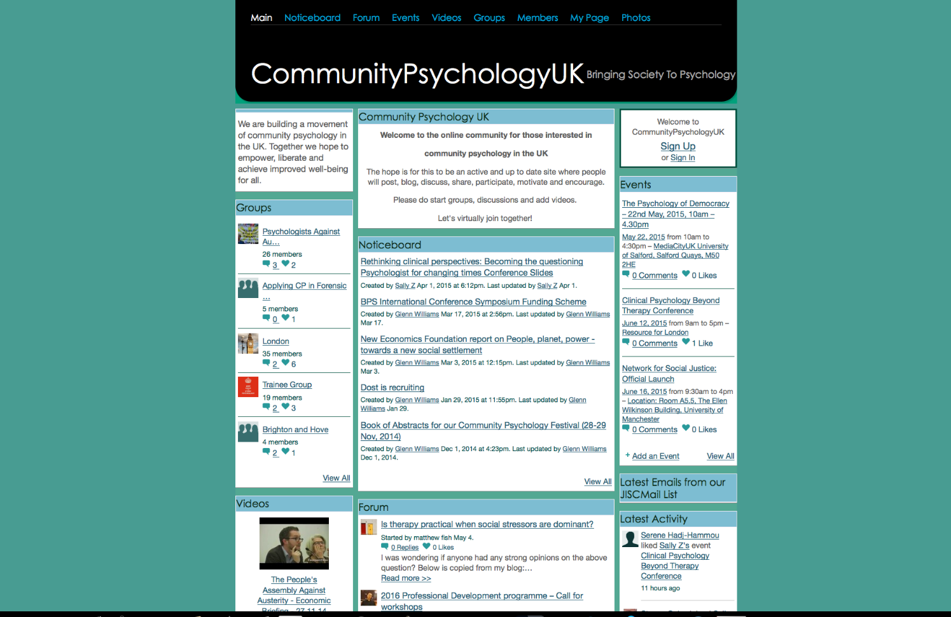
London Community Psychology Network
Network of academic and applied psychologists (and students and professional doctorate trainees) in London interested in community psychology
Concern about deleterious effects of inequality -- increasingly recognised as an issue of social justice and public health

Slide 62


Slide 63
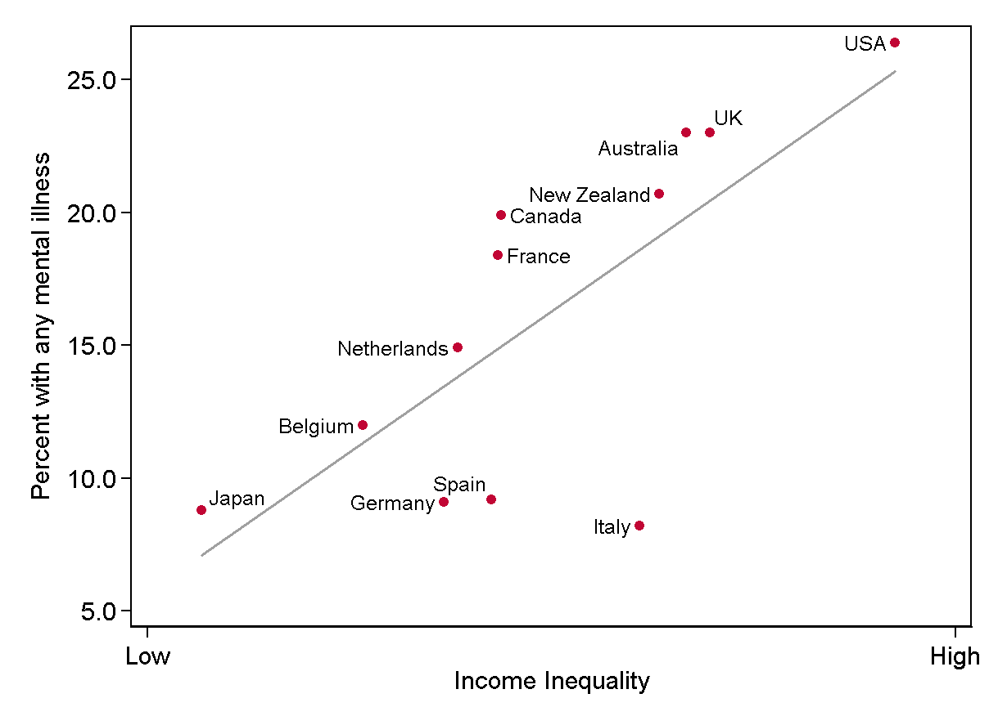
The links between psychological distress and social inequality
Wilkinson & Pickett, The Spirit Level
www.equalitytrust.org.uk
Notes:
63

Slide 64
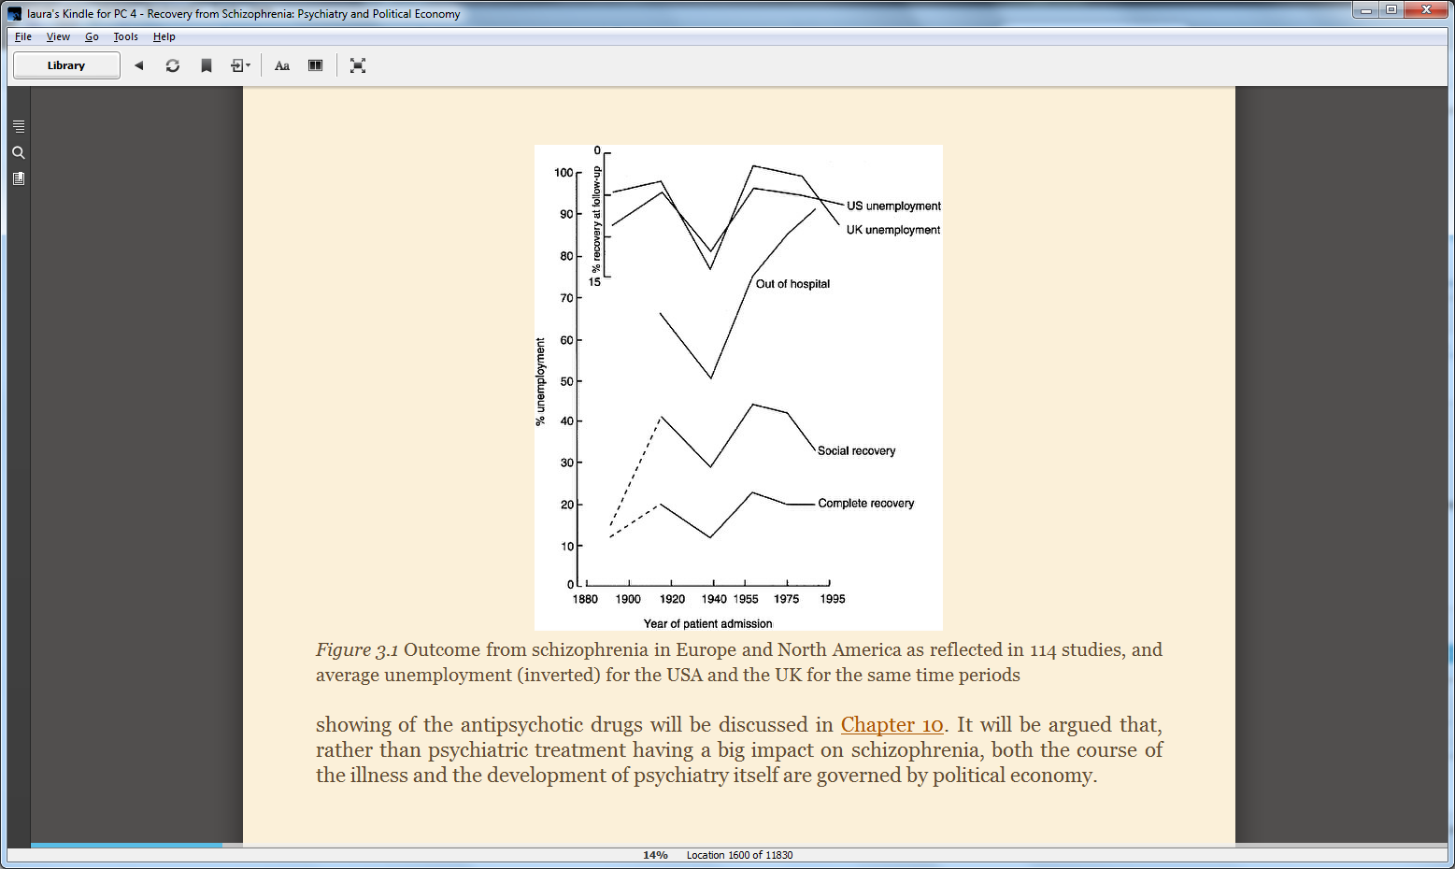
Economy and mental health
Lots of known links between the economy and mental health
  “Class gradient” in diagnosed mental health problems (Rogers & Pilgrim, 2010).
  Recovery from ‘schizophrenia’ better in times of higher employment (Warner, 2000).
  Stuckler et al. (2009). 1970 to 2007 in 26 European countries: every 1% increase in unemployment corresponded to .79% rise in suicides.
  Financial crisis, recession, and rising inequality all pose a potential problem for public mental health.

Slide 65
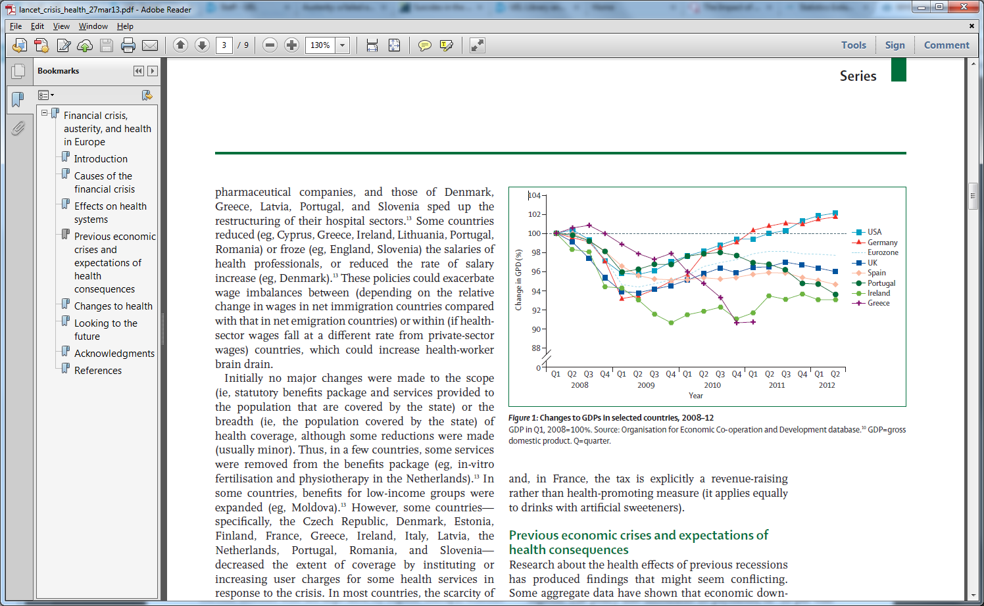
What is austerity?
Financial crisis means that there is less money is flowing around the economy.
Different approaches:
  Austerity = welfare state is unaffordable and needs to be cut, aim of shrinking the government and increasing the private sector. This takes money out of the economy.
  Stimulus = economy is stagnant and needs money pumped into it – through government providing jobs, supporting sectors of the economy (eg – cars in USA). This puts money into the economy.
Worldwide:
Austerity = UK, Greece, Spain, Portugal, Ireland.
Stimulus = USA, Germany, Iceland.

Slide 66
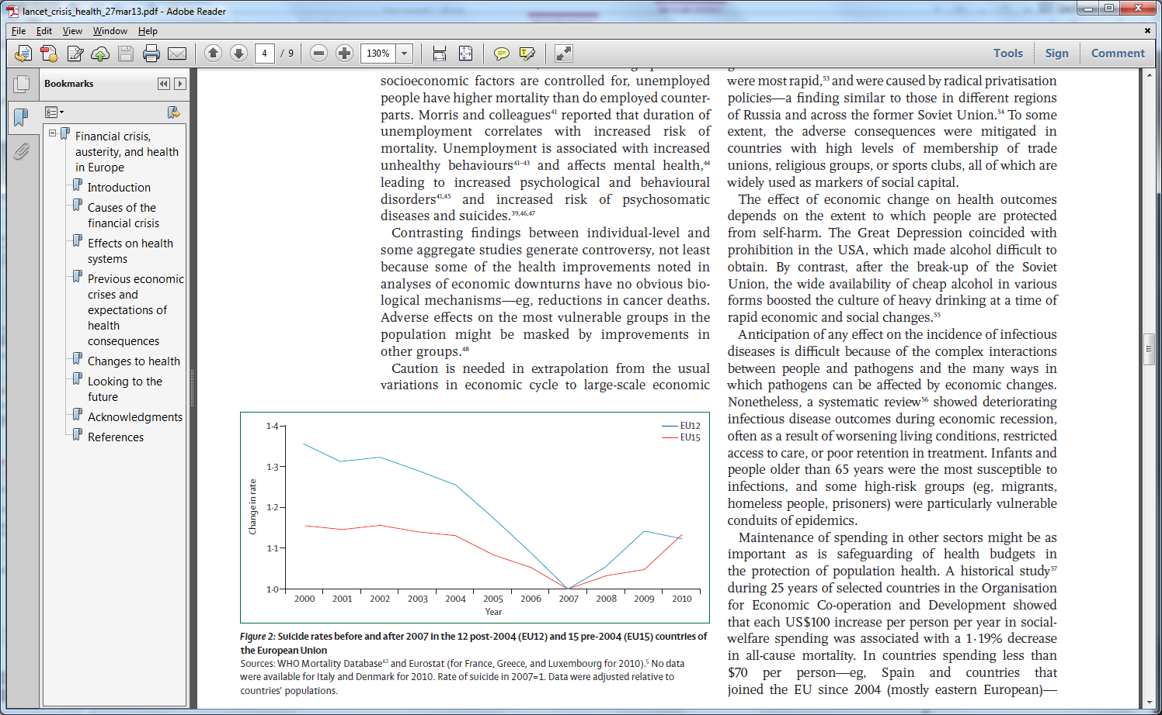
Mental health impacts of austerity
Rise in anti-depressant prescriptions (Spence et al, 2014).
GPs have reported increased mental health problems.
Male suicides have increased in the UK (ONS, 2015).
  Suicide increases: Greece, Spain, Portugal, UK.
  No suicide increases: Germany & Iceland.
Same pattern in other health indicators.
(Karanikolos et al, 2013; McKee et al, 2012).

Slide 67
Psychologists against austerity
Two aims:
Raising awareness amongst Psychologists
- Building networks locally and nationally: applied, academic and trainee psychologists.
- ‘Week of Action’ before the election – addressing all the main parties who advocated ‘austerity’ policies
Informing public debate
- Adding psychological perspectives, research and expertise to the debate in the political sphere.
- Briefing paper ‘The Psychological Impact of Austerity’.

Slide 68
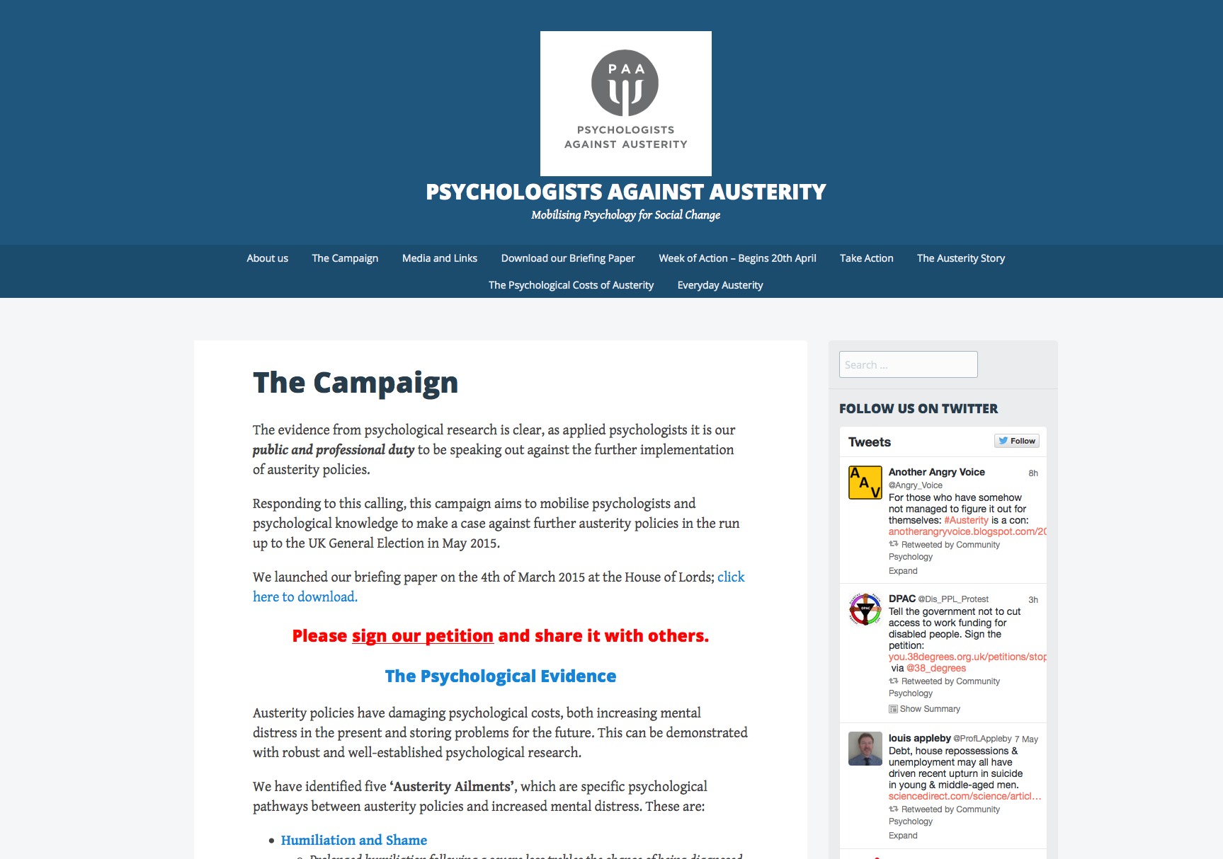

Slide 69
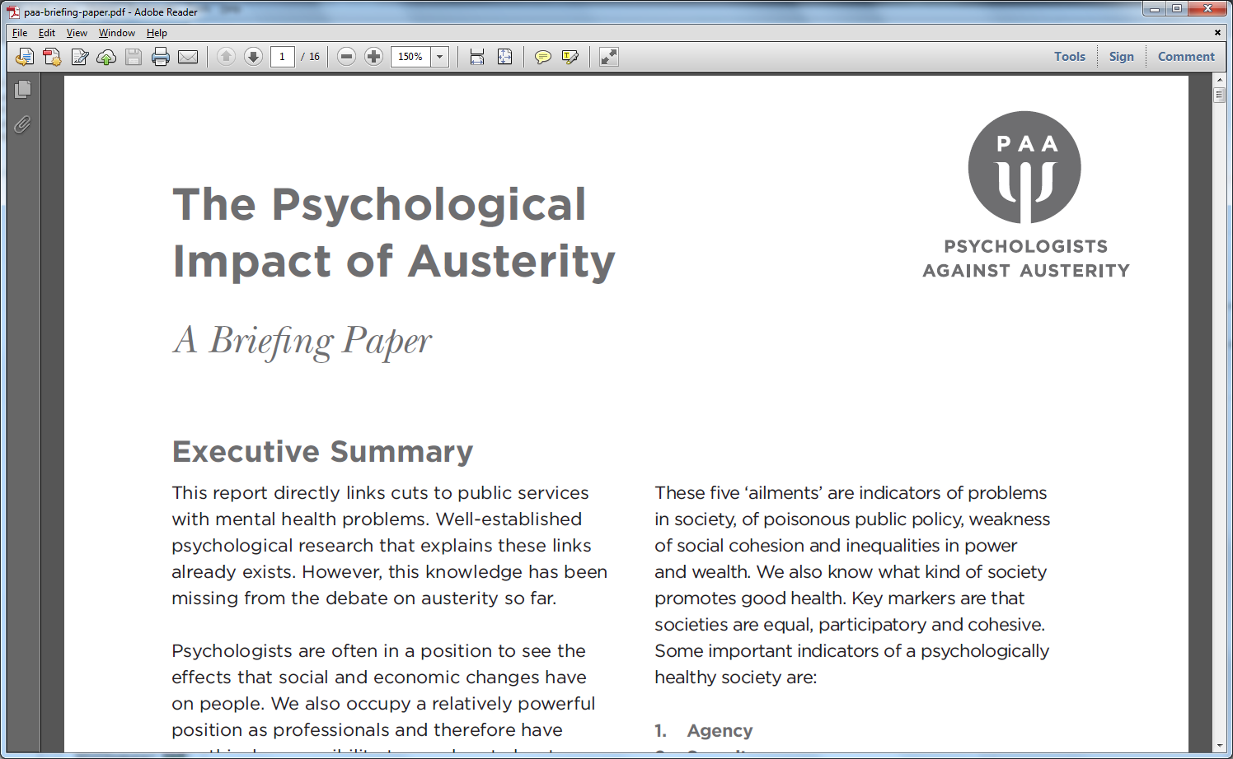
Five ‘Austerity Ailments’ Five indicators of a ‘healthy’ society
  Humiliation and Shame Agency
  Fear and Distrust Security
  Instability and Insecurity Connection
  Isolation and Loneliness Meaning
  Being Trapped Trust

Slide 70
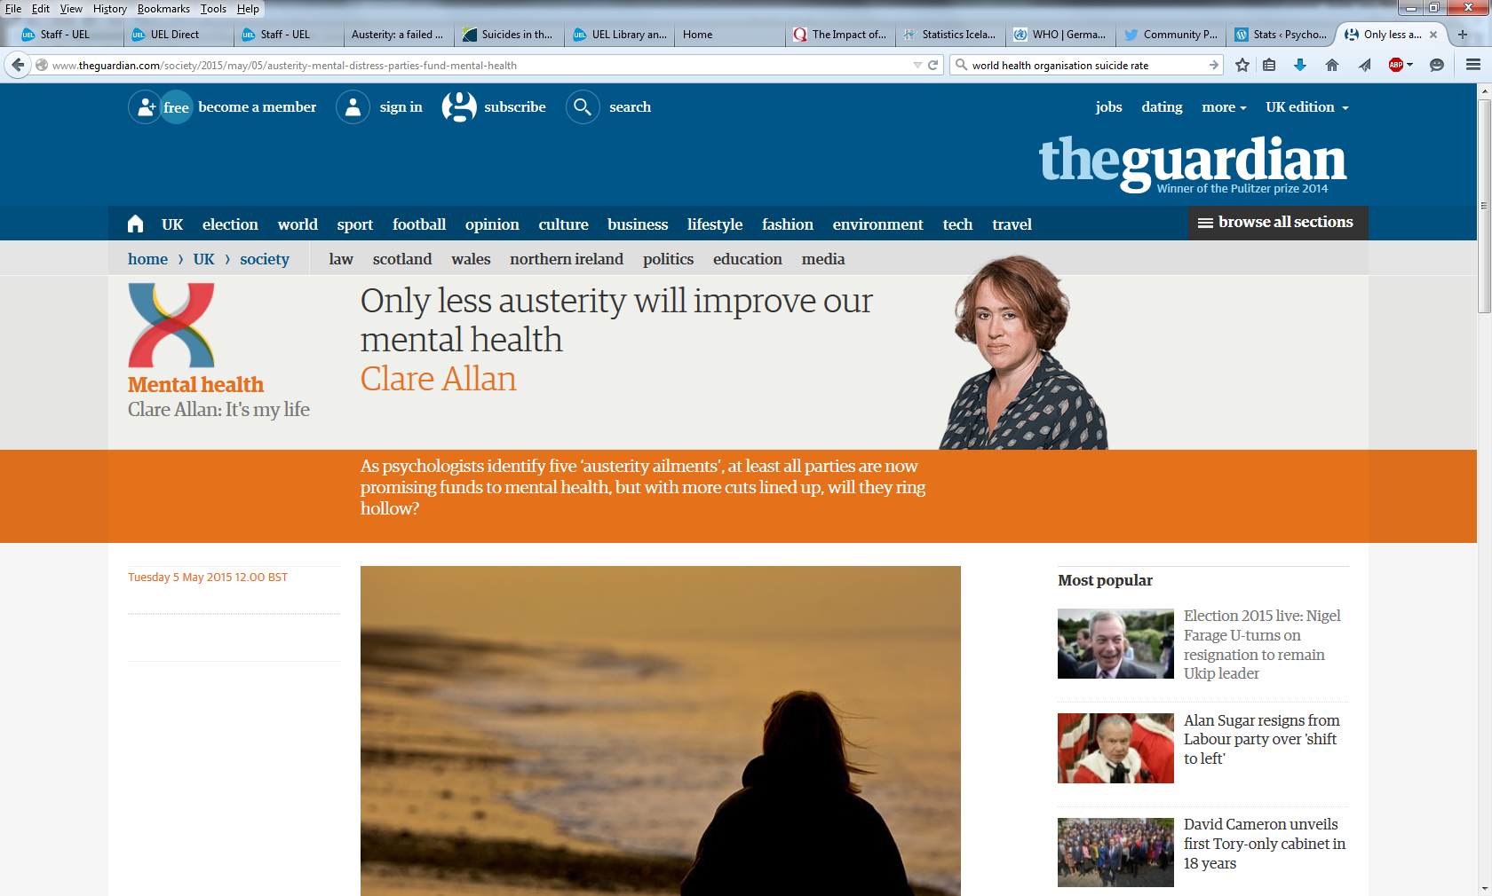
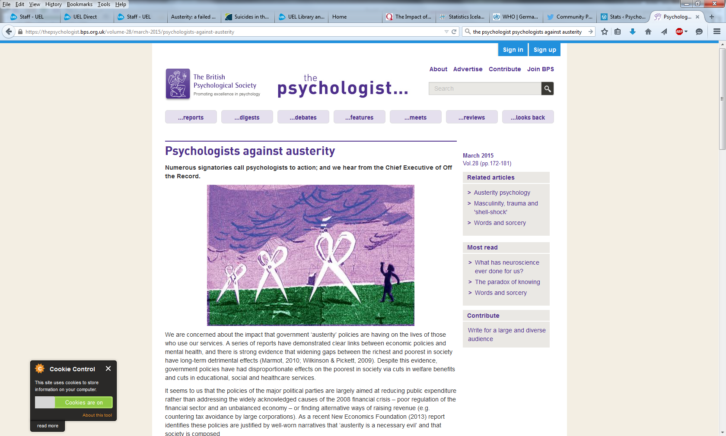

Impacts
Launch at the House of Lords.
Media: The Guardian (article and letter); Vice; Hayes Radio; Mary O’Hara; New Internationalist; The Psychologist.
Briefing paper: MPs, Councillors, and London Assembly Members. Relevant charities (Sane, Children’s Society, Barnardos etc). Practising psychologists and academics.
Organisation links: New Economics Foundation, DPAC, Black Triangle, Alliance of Counsellors and Psychotherapists, Economic Justice.
Grown to 40 active members, 150+ on mailing list. Regional groups in Scotland and North West. Website (200-400 hits per day).

Slide 71
Austerity in the workplace
2012 study (17,000 participants) found 40% higher work stress during recession with 1 in 4 workers experiencing work related stress.
Austerity ailments can all be manifested in the workplace
Instability and insecurity is one of the austerity ailments most relevant to workplace stress
Job insecurity is as detrimental to mental health as unemployment
Job insecurity leads to poor mental health outcomes independent of income or occupation

Slide 72
What can trade unions do?
Organising as part of trade union/collective action can be empowering and can promote 5 key indicators of a healthy society:
Agency, Security, Connection, Meaning & Trust
What can trade unions do to include the increasing proportion of workers who are employed on 'zero hours contracts' or other precarious arrangements?

Slide 73
Case-law update: opportunities & challenges
Elizabeth Stephenson.
Pattinson & Brewer
#ierelu
2nd December, 2015
The Adelphi Hotel, Liverpool
www.ier.org.uk
www.ier.org.uk

