Slide 1

Post-Brexit TUPE
by David Sorensen, partner
Morrish Solicitors LLP
To the Institute of Employment Rights, 30 November 2017
Notes:
1

Slide 2

TUPE – life before it
Not good
Under the law, the transfer of a business had the effect of automatically terminating contracts of employment with resulting dismissals
Unfair dismissal, wrongful dismissal, wages and redundancy pay against the employer
If the employer was insolvent, limited practical remedy
No liability passed to the new employer
Easy for business to avoid responsibilities by changing their legal structure
Notes:
2

Slide 3

Acquired Rights Directive 1977….
Notes:
3

Slide 4
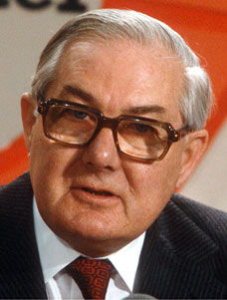

Acquired Rights Directive 1977….
Notes:
4

Slide 5
Acquired Rights Directive 1977
77/187 EEC
‘to provide for the protection of employees in the event of a change in employer, in particular, to ensure that their rights [were] safeguarded’
A 2 year deadline to implement by…
Notes:
5

Slide 6
1979
But something else happened that year….
Notes:
6

Slide 7

1979 – Conservative government
Notes:
7

Slide 8
TUPE – no, no, no?
EEC infraction proceedings…..
Notes:
8

Slide 9
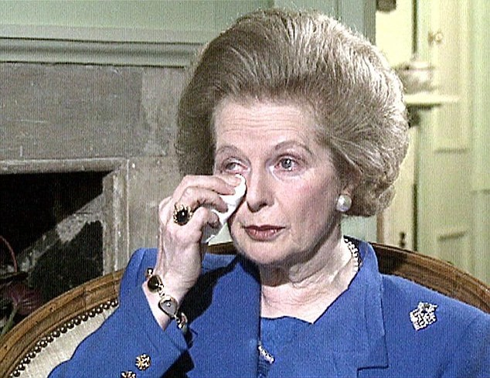
TUPE – er yes, yes, yes
Notes:
9

Slide 10
TUPE 1981
Came into force in 1982, 3 years late
However, the drafting was very poor leading to poor clarity
Big differences between the EEC Directive and the Regulations
This led to misunderstandings and complexities
& a large number of legislative changes
e.g. 1993, 1995 and 1999 changes to rectify information and consultation rights alone
Notes:
10

Slide 11
TUPE 1981 – what did it do?
What is it?
What does it do?
Who and what transfers?
Objecting
Duty to inform and consult
Dismissals
Changes
Notes:
11

Slide 12
TUPE purposive approach
Ethos is to protect employees
UK courts resilient at interpreting it in this way
Good example of EU legislation affecting a change in UK Judges’ approach, moving from literal interpretation to purposive interpretation i.e. the purpose of the legislation
Notes:
12

Slide 13

1997 – Labour government
From Categories Subject Size Received
Neil Guss (Thompsons Solicitors) RE: Unite Officer and lawyer training at Wortley Hall on 28 November 2017 76 KB 14:38
Notes:
13

Slide 14
TUPE 2006 changes
TUPE re-booted
Added protections – ‘gold-plating’
Brought in service provision change (SPC) transfer
Required transferor to provide employee liability information
Notes:
14

Slide 15
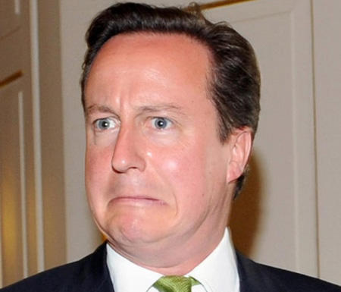
2010 ConDem government
Notes:
15

Slide 16
TUPE 2014
A watering down process
SPC – activities must remain fundamentally the same to be an SPC
Easier to change terms and conditions
Easier to change workplace location post-transfer
Easier to dismiss
Excludes micro-business (less than 10 employees) from part of the information and consultation duty
Notes:
16

Slide 17
Today’s TUPE
Overall, provides employee protection despite the 2014 changes
ECJ case-law in recent years has been more employer-friendly than employee-friendly
UK case-law has leaned towards employee-protection
Notes:
17

Slide 18
Tomorrow’s TUPE post-Brexit
Well……
Notes:
18

Slide 19
Tomorrow’s TUPE post-Brexit
Legislation changes:
Stay or go?
In pre-2014 changes consultation, majority of employer’s wanted TUPE to remain in place albeit altered
Back to the 1970s?
Notes:
19

Slide 20
Tomorrow’s TUPE post-Brexit
Stay but with amends:
Reduce information and consultation requirements
Easier to harmonise terms and conditions post-transfer e.g. time limit on how long t’s and c’s last?
Easier to dismiss
Widen insolvency provisions to promote companies (private equity…) purchasing insolvent businesses
Notes:
20

Slide 21
Tomorrow’s TUPE post-Brexit
Caselaw changes:
New EU caselaw may no longer apply from ‘exit date’
‘Old’ EU caselaw will apply, as will precedent UK caselaw
UK courts - Supreme Court will be crucial…..
Notes:
21

Slide 22
Any questions?
Notes:
22

Slide 23


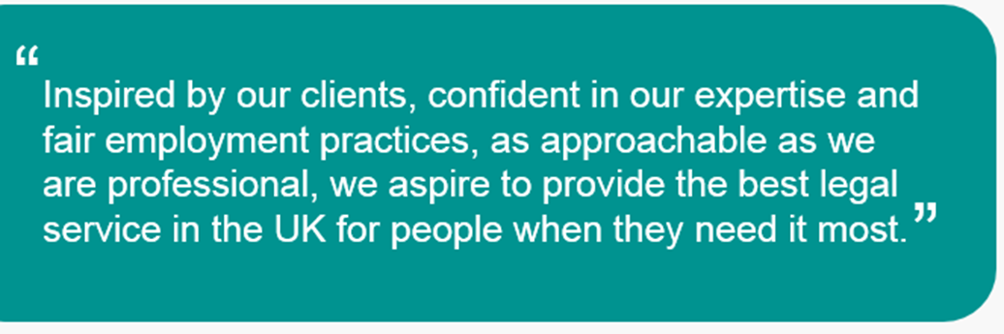

“
Notes:
23

